Slide 1
SSL / TLS / HTTPS Best Practices
Notes:
Cryptography
Cryptography provides you with two services: confidentiality and integrity. Confidentiality is achieved with encryption, and integrity is attained with a message authentication code (MAC). They allow you to keep information secret and detect when the information has been tampered.
Cryptography is usually not attacked since it’s easier to circumvent it. Attacks like factoring the Texas Instruments TI-83+ signing key are rare. It’s easy to go over the top with cryptography, and the recommendations below will present a basic set of practical rules for securing data-at-rest and data-in-transit (there are other tricks for securing data-on-display, but they are not included in this guide).
You should make your cryptography easy to use, and hard to misuse. As soon as you add a human to the loop you should expect trouble. And if you make it hard to use then users will avoid it or turn it off. Some of the most successful programs with cryptographic elements “do the right thing” for the user and don’t nag them with questions they don’t understand. For example, the Off The Record (OTR) plugin for Pidgin Instant Messenger (IM) program generates a public/private key, packages the public key in a certificate, and then uses the certificate to secure communications without prompting the user.
You should understand that key storage for unattended devices (such as a headless server or locked mobile device) is a problem without a solution. If you don’t have a user available, you will have to store the key somewhere.
You should always ask the user for a secret or entropy (such as a PIN, Password, or Passphrase). Its perfectly fine to use the Password alone or Password + Keystore Secret to derive a key. If using the Keystore Secret alone, then you backed yourself into the “key storage for unattended devices” problem that does not have a solution.
You should hedge entropy for program running on a virtual machine, headless server, mobile device, and other low entropy machines. Hedging refers to taking random information, such as the other party’s nonce or public key used in a key exchange, and adding the entropy to your random number generator. The measures are needed due to problems caused by playback (virtual machines) and entropy starvation (headless servers and mobile devices).
Whenever you think of encryption, you should think authenticated encryption. Authenticated encryption provides both confidentiality and integrity. It’s somewhat rare to need encryption but not authentication or integrity. If you don’t check authenticity, then you should treat the data, such as a configuration file, as untrusted input.
When you need a block cipher, use 3-key TDEA (Triple DES), AES, Camellia, or other modern block cipher. You should pair the block cipher with an appropriate mode – such as EAX, CCM, or GCM. EAX, CCM, and GCM are authenticated encryption modes, they are easy to use, and handle a number of details for you. CBC mode is not recommended because it means you have to combine the encryption primitive with the integrity primitive after independently deriving keys.
When you need a hash, use the SHA-2 family or Whirlpool. When you need a keyed hash (HMAC), use the SHA-2 family or Whirlpool as the underlying hash. If you do business with the government in the US, you can’t use SHA-1 even though it’s still durable.
If you are using Public/Private Key Pairs (PPKP), such as RSA, then you should use RSA-OAEP for encryption and RSA-PSS for signing. PKCS padding often allows for key extraction (from a hardware device) or key recovery (from a remote server).
Never handle a plain text password. Perform a one-way transformation, such as a hash, HMAC, or PBKDF, on the password as soon as it’s read from the console, TextEdit, UITextField, or other control. Attempt to clear or wipe the memory used by the console, TextEdit, UITextField or other control on destruction.
If your application or hardware allows remote access, then be sure to use a unique password or public/private key pair for each instance of the application or hardware. Barracuda has used hard coded backdoors for years, and they earned CVE-2006-4082 (devices are still vulnerable in 2013). Littleblackbox (http://code.google.com/p/littleblackbox/) is a database of private keys for applications and devices that re-use the same key pair, and you should not strive for membership.
When using SSL/TLS, understand the Internet’s PKI (RFC 5280) has some problems in practice. The problems lie in both PKI and the Internet profile, and Dr. Peter Gutmann tells us the whole PKI system should be scrapped. Scrapping PKI effectively scraps SSL/TLS (which many can’t do), so you will have to take steps to work with SSL/TLS safely.
Server authentication is a big problem with PKI and the Internet profile. The problem is you never really know whom you are talking to, and it’s the reason basic_auth is so dangerous. In fact, CAs explicitly shed liability for end-entity identification (in addition to nearly all other liabilities) and leaves it up to the Relying Party (which is you) to determine identity.
If you have worked with the Internet PKI in practice, then you know the inconsistent results produced by path validation, validity checking, name checking, key usage and extended key usage. Not only is it the wild, wild, west, the system also rejects valid self-signed certificates providing opportunistic encryption!
To overcome the server identity problem, you can use TLS-PSK or TLS-SRP (only an authorized sever has access to the user’s password from provisioning or account setup); or you can use certificate or public key pinning (only an authorized server holds the private key for an expected public key).
If you access remote systems with a password, you should never use a basic_auth scheme inside a SSL/TLS tunnel. Basic_auth places the password on the wire in the plain text, so whoever has the listening socket open at the other end gets a username and password for nearly no work. Instead of basic_auth, you should use TLS-PSK or TLS-SRP, for which IANA has reserved over 80 cipher suites so there’s no shortage. Pre-Shared Key (TLS-PSK) and Secure Remote Password (TLS-SRP) properly bind the outer encryption tunnel to the inner authentication mechanism, so the password is never directly used in the plain text. Either both sides will have knowledge of the secret, or secure channel setup will fail with no leaks.
Pinning is a key continuity scheme, and the idea is to either (1) carry around a copy of the server’s public key; or (2) note of the server’s public key on first use (Trust-on-First-Use, Tofu). The former is great if you are distributing a dedicated client-server application since you know the server’s certificate or public key in advance. The latter is useful when no a priori knowledge exists, such as SSH or a Browser. Both detect the unexpected change that occurs when an imposter with a fake certificate attempts to act like the real server.
While you have a choice to pin the certificate or public key, it’s often best to pin the public key. That is because some companies, such as Google, rotate its certificate regularly (every 30 days or so) but re-certifies the inner public key.
Finally, you should use an established library for your cryptographic needs. Libraries on your platform include the Security framework for Mac OS X and iOS, and Window’s CryptoAPI (CAPI). Linux users will use one of the many third party libraries offered by the distribution. Established third party libraries include Botan, Crypto++, Cryptlib, GnuTLS, libgcrypt, NaCl (Salt), Network Security Services (NSS), and OpenSSL.
Fedora Crypto Consolidation, http://fedoraproject.org/wiki/FedoraCryptoConsolidation

Slide 2


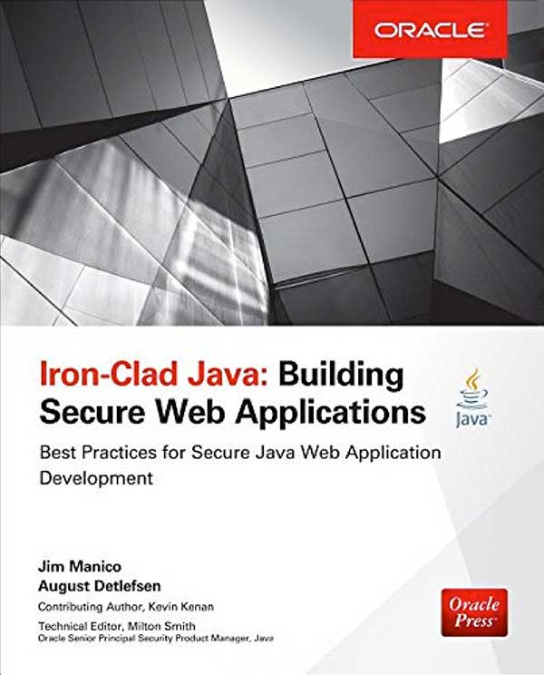
A little background dirt…
jim@manicode.com
@manicode
    Former OWASP Global Board Member
    Project manager of the
    OWASP Cheat Sheet Series and
    several other OWASP projects
    20+ years of software
    development experience
    Author of "Iron-Clad Java,
    Building Secure Web Applications”
    from McGraw-Hill/Oracle-Press
    Kauai, Hawaii Resident

Slide 3
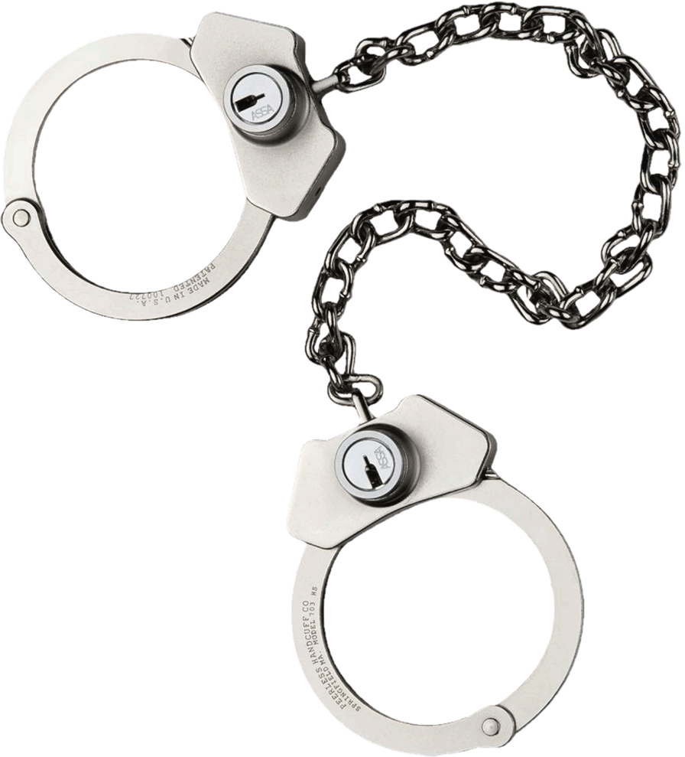
WARNING: Please do not attempt to hack any computer system without legal permission to do so.
Unauthorized computer hacking is illegal and can be punishable by a range of penalties including loss of job, monetary fines and possible imprisonment.
ALSO: The Free and Open Source Software presented in these materials are examples of good secure development tools and techniques. You may have unknown legal, licensing or technical issues when making use of Free and Open Source Software. You should consult your company's policy on the use of Free and Open Source Software before making use of any software referenced in this material.

Slide 4
Where are we going?
What is SSL / TLS / HTTPS?
TLS Configuration
Strict Transport Security (HSTS)
Forward Secrecy
Certificate Pinning

Slide 5

“Any unencrypted traffic, visible to an adversary, is not just an information leak, but an attack vector they can use to exploit your systems.”
Nick Weaver

Slide 6

“Cryptography is only truly useful if the rest of the system is also sufficiently secure against the attackers.”
Bruce Schneier
Security Engineering

Slide 7
Bypassing TLS
Cryptography is solid but the implementation has flaws
  Browser fail open policy
  Too much trust on certificate authorities
  Revocation capability is limited and doesn’t scaled
Some of the most popular algorithms need to be decommissioned
Cryptography is bypassed,
not attacked
Notes:
Cryptography is bypassed not attacked. The primitives are solid but the implementation has flaws (e.g. time attacks, coding errors)
Why spend months trying to brute force the key when it might be a lot easier to break into a server?
Page 17 - Cryptography is bypassed not attacked. The primitives are solid but the implementation has flaws (e.g. time attacks, coding errors)

Slide 8
SSL
Secure Sockets Layer
TLS
Transport Layer Security

Slide 9

What’s another way of looking at it?
Confidentiality
Spy cannot view your data
Integrity
Spy cannot change your data
Authenticity
Server you are visiting is the right one,
backed up by the Certificate Authority System

Slide 10
HTTPS / TLS: When and How
Where should HTTPS be used at minimum?
EVERYWHERE &
ALWAYS
HTTPS configuration best practices:
  https://wiki.mozilla.org/Security/Server_Side_TLS#Recommended_configurations
  https://www.owasp.org/index.php/O-Saft
  https://www.ssllabs.com/projects/best-practices/

Slide 11
SSL / TLS Protocols
SSL v2 Fully broken. Do not use!
SSL v3 Also fully broken from "POODLE" class attacks
TLS 1.0 “OK” but on its way out
TLS 1.1 No known practical attacks
TLS 1.2 Best available; includes new ciphers
TLS 1.3 New standard in "last call" mode (Feb 2018)
Notes:
IVAN: - #16: SSLv1 was never released so no one can use it
https://www.ietf.org/mail-archive/web/tls/current/msg25387.html

Slide 12
TLS and June 30, 2018
June 30, 2018 is the deadline for enabling TLS v1.1 or higher in order to meet the PCI Data Security Standard (PCI DSS) for safeguarding credit card payment data
TLS v1.2 is strongly encouraged
Notes:
IVAN: - #16: SSLv1 was never released so no one can use it

Slide 13
Trajectory and Growth of Encryption
SSL growing ~30% annually. Entering the Fifth wave of transition (IoE).
E-Commerce
Privacy
Snowden
IoE
Lets
Encrypt
Millions of Certificates (CA)
Mobility
Source: Netcraft
Notes:
Source: Netcraft
Key points:
1.) Trends continue to drive an Encryption Everywhere mantra with no slow down in site
This shows the millions of certificates issued each year. We also see about 30-40% of all outbound traffic in most enterprises as SSL encrypted, up from 5-10% just a few years ago. Google and Microsoft are using their influence to drive better encryption practices, which will discuss in more detail later.

Slide 14

In a nutshell…
SSL stands for Secure Sockets Layer (1994)
TLS stands for Transport Layer Security
and is just the new name for SSL
TLS 1.0 == SSL 3.1
TLS 1.1 1999
TLS 1.2 2008
TLS 1.3 2017 Draft Status
HTTPS is Hypertext
Transport Protocol Secure
and provides HTTP
over SSL/TLS

Slide 15

TLS Protocol Workflow
TLS uses both Symmetric and Asymmetric encryption
TLS exchanges Symmetric keys encrypted with Asymmetric keys,
then falls back to Symmetric encryption
Why?
Symmetric encryption is MUCH faster
Asymmetric is slower but is used for authentication
Notes:
IVAN TODO: Asymmetric encryption is used for authentication, key exchange algorithms to, well exchange keys. It's true that assym. crypto was used for kx, but that was the RSA kx, which is now deprecated.

Slide 16
TLS Certificates
TLS uses X.509 Certificates
Used to authenticate the other party
NOT used to help negotiate a symmetric key (beyond authentication)
TLS certificates from certificate authorities help websites prove their authenticity.
There certificates contain:
The certificate holder
The domain that the certificate was issued to
The signature of the Certificate Authority who verified the certificate
Can have multiple hostnames via SAN
Notes:
IVAN: certs don't help negotiate a sym. key, beyond auth of course-
certs can have multiple hostnames via SAN
When using SSL/TLS, understand the Internet’s PKI (RFC 5280) has some problems in practice. The problems lie in both PKI and the Internet profile, and Dr. Peter Gutmann tells us the whole PKI system should be scrapped. Scrapping PKI effectively scraps SSL/TLS (which many can’t do), so you will have to take steps to work with SSL/TLS safely.
Server authentication is a big problem with PKI and the Internet profile. The problem is you never really know whom you are talking to, and it’s the reason basic_auth is so dangerous. In fact, CAs explicitly shed liability for end-entity identification (in addition to nearly all other liabilities) and leaves it up to the Relying Party (which is you) to determine identity.
If you have worked with the Internet PKI in practice, then you know the inconsistent results produced by path validation, validity checking, name checking, key usage and extended key usage. Not only is it the wild, wild, west, the system also rejects valid self-signed certificates providing opportunistic encryption!
To overcome the server identity problem, you can use TLS-PSK or TLS-SRP (only an authorized sever has access to the user’s password from provisioning or account setup); or you can use certificate or public key pinning (only an authorized server holds the private key for an expected public key).
If you access remote systems with a password, you should never use a basic_auth scheme inside a SSL/TLS tunnel. Basic_auth places the password on the wire in the plain text, so whoever has the listening socket open at the other end gets a username and password for nearly no work. Instead of basic_auth, you should use TLS-PSK or TLS-SRP, for which IANA has reserved over 80 cipher suites so there’s no shortage. Pre-Shared Key (TLS-PSK) and Secure Remote Password (TLS-SRP) properly bind the outer encryption tunnel to the inner authentication mechanism, so the password is never directly used in the plain text. Either both sides will have knowledge of the secret, or secure channel setup will fail with no leaks.
Pinning is a key continuity scheme, and the idea is to either (1) carry around a copy of the server’s public key; or (2) note of the server’s public key on first use (Trust-on-First-Use, Tofu). The former is great if you are distributing a dedicated client-server application since you know the server’s certificate or public key in advance. The latter is useful when no a priori knowledge exists, such as SSH or a Browser. Both detect the unexpected change that occurs when an imposter with a fake certificate attempts to act like the real server.
While you have a choice to pin the certificate or public key, it’s often best to pin the public key. That is because some companies, such as Google, rotate its certificate regularly (every 30 days or so) but re-certifies the inner public key.

Slide 17
Digital Signatures

Slide 18
Data Integrity and Message Authentication
Symetric Key (single key) Integrity: Keyed-Hash MAC's (Message Authentication Codes)
Does not separate read/write (i.e. verify/sign) privileges; the same key is used for both;
Offers much better performance than digital signatures; and
Requires much smaller key sizes than digital signatures.
Asymmetric Key (key pair) Integrity: Digital Signatures
Separate read/write (i.e. verify/sign) privileges; a public key is used for one, alongside a private key for the other;
Performance is much worse than message authentication codes; and
Requires much larger key sizes than message authentication codes.
Notes:
There are two types of primitives that provide data integrity and message authentication: Keyed-Hash Message Authentication Codes (Symmetric key), and Digital Signatures (Asymmetric keys).
Similar to symmetric encryption, HMAC's:
• do not separate read/write (i.e. verify/sign) privileges; the same key is used for both;
• offer much better performance than digital signatures; and
• require much smaller key sizes than digital signatures.
Conceptually, HMAC's are simply hash functions that take a secret key as one of their inputs.
Similar to asymmetric encryption, digital signatures:
• Separate read/write (i.e. verify/sign) privileges; a public key is used for one, alongside a private key for the other;
• the performance is much worse than message authentication codes; and
• require much larger key sizes than message authentication codes.

Slide 19
Digital Signature
A cryptographic primitive that ensures:
  Data origin authentication of the signer
  Integrity of the data
  Non repudiation
Basic properties
  Easy for the signer to sign data
  Easy for everyone to verify the signature
  Hard for anyone to forge a signature
  Possible to have a third party settle any disputes

Slide 20
Confidentiality?
Digital signatures do not provide confidentiality!!
You will need to use some form of encryption for that
Notes:
if we need confidentiality we need to sign AND encrypt the message (but not necessarily in that order!)

Slide 21
RSA digital signature scheme with appendix
Goal: authenticity and integrity
Usually named after the algorithms used.
  E.g. RSA-MD5
Digitally-signed
message
Message
+
Encryption
Hash
Function
Digest
Digital
Signature
Private
key
Notes:
we take a hash of the original message. Then the hash is encrypted using the sender’s private key.
The resulting encrypted hash is called a “digital signature” and is attached to the message.

Slide 22
Verifying a digital signature
Digitally-signed
message
Hash function
Digest
Message
If identical, ok
Decryption
=;
Digest’
Public
key
Notes:
the recipient computes the hash of the received message
subsequently the digital signature (sender’s encrypted hash) is decrypted using the sender’s public key (publicly available e.g. in a certificate).
if the resulting hash is identical to the hash of the received message the signature is verified.

Slide 23
Why hash?
Integrity
  An attacker can change a message (e.g. rearrange blocks)
  An attacker might be able to even “sign” a forged message
Efficiency
  RSA is a computationally expensive algorithm
  Better to sign a small amount of data (hash) rather than the entire message

Slide 24
Relationship between CAs
Cross certification
  Each CA certifies the other CA’s public key.
CA Hierarchies
  Introduce different levels of CAs
Certificate chain of trust
  A series of difference certificates that need to be verified in order to achieve trust end-to-end.

Slide 25
HTTPS Historical Problems

Slide 26

Other SSL Fails
Posting passwords or other sensitive data over HTTP
Loading mixed content
Using weak version of SSL or TLS
Using weak ciphers
Terminating TLS early in
your infrastructure
Trusting the CA system
Using old OSs or Webservers
Old versions of OpenSSL
Notes:
BC: Heartbleed as example of insecure SSL version

Slide 27

HTTPS / SSL Protocol #fail
2011 BEAST
Upgrade to TLS 1.1
Use RC4 for older protocols.
Mitigated by browsers
2012 CRIME
Stop using TLS compression
2013 BREACH
Vendors disabled HTTP compression in client and server side
Mask Sensitive tokens, randomize them per request
2014 Heartbleed
Abuse the heartbeat feature in OpenSSL to retrieve
chunks of memory for the server
2014 POODLE
Death of SSL 3.0
2017 FREAK
Refactoring RSA Export Keys
Notes:
IVAN: Heartbleed is not an SSL fail ;)
BEAST 2011 – Predict the Initialization Vector (IV) in CBC mode to decode the message. At the time the best solution was to use a stream algorithm such as RC4. Fixed in TLS 1.1 and above. The attack is against the client (browser)
http://en.wikipedia.org/wiki/Transport_Layer_Security#BEAST_attack
CRIME 2012 – Exploits the fact that TLS compression is based on patterns. Attacker tries to guess a pattern and determines if the guess was correct by observing the compressed result. If it compresses well, then he knows the string was right. This attack works against TLS. IE, Safari and Opera do not offer TLS compression and were not affected.
http://resources.infosecinstitute.com/beast-vs-crime-attack/
BREACH 2013 – Inject plain text in the into victims HTTP request and measure the size of the request.
http://breachattack.com/
Heartbleed
http://heartbleed.com/

Slide 28

POODLE (Padding Oracle On Downgraded Legacy Encryption)
POODLE is a flaw that exploits the lack of padding verification in SSL3. TLS 1+ does, which is why POODLE doesn't affect it.
Plausible attack scenario targets session cookie data
  Attacker runs fake WIFI
  Injects evil JavaScript into HTTP site user is visiting
  Evil JS makes requests to HTTPS target application
  Attacker causes TLS failure triggering the use of SSL 3.0
  Uses Oracle Padding attack (like CRIME and BEAST)
  Victims session cookie is discovered byte by byte
Disable SSL 3.0 for all servers and clients
Use TLS_FALLBACK_SCSV
Notes:
IVAN: - #18: this list is not comprehensive, but it doesn't matter; in my course I don't even have a slide like this; I only mention CRIME because it's practical
Unlike with the BEAST [BEAST] and Lucky 13, there are no reasonable workarounds.
Integrity of padding (CBC mode) cannot be verified when decrypting.
If SSL 3.0 is neither disabled nor the only possible protocol version, then the attack is possible if the client uses a downgrade dance for interoperability
Firefox can prevent this dance from happening: Set security.tls.version.min to 1 (means tls 1). 2 means tls 1.1
"To work with legacy servers, many TLS clients implement a downgrade dance: in a first handshake attempt, offer the highest protocol version supported by the client; if this handshake fails, retry (possibly repeatedly) with earlier protocol versions. Unlike proper protocol version negotiation (if the client offers TLS 1.2, the server may respond with, say, TLS 1.0), this downgrade can also be triggered by network glitches, or by active attackers. So if an attacker that controls the network between the client and the server interferes with any attempted handshake offering TLS 1.0 or later, such clients will readily confine themselves to SSL 3.0.“
Chrome users that just want to get rid of SSLv3 can use the command line flag --ssl-version-min=tls1 to do so.
Original whitepaper: https://www.openssl.org/~bodo/ssl-poodle.pdf
Adam Langley’s blog: https://www.imperialviolet.org/
Best whitepaper: https://www.dfranke.us/posts/2014-10-14-how-poodle-happened.html

Slide 29
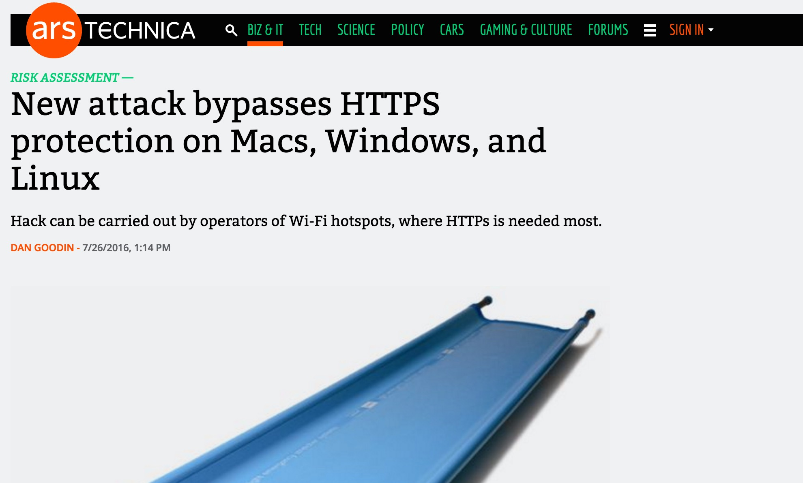
July 26, 2016

Slide 30
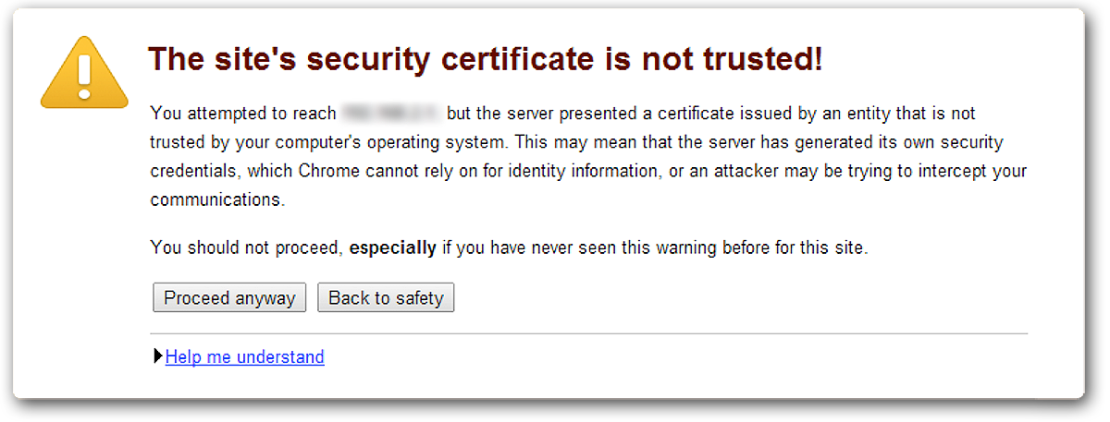

HTTPS / TLS Browser #fail
It worked yesterday…
The effects of a “fail open/soft fail” policy
  30-70% of the users click through warnings*
  Completely defeats the purpose of encryption
  No good way to change browser behavior,
  until recently
* http://www.cs.berkeley.edu/~devdatta/papers/alice-in-warningland.pdf
Notes:
What about QA? Is it okay for them to click thru warnings? No because it may mask potential production issues later.
Certificate warnings defeat the purpose of encryption
Possibly the biggest failure of Internet PKI (or Web PKI, to be more accurate) is a lax
approach to certificate validation. Many libraries and applications skip it altogether.
Browsers check certificates, but, when an Invalid certificate is encountered, they present
the users with warnings that can be bypassed. According to some studies, from 30% to
7()% of users click through these warnings, which completely defeats the purpose of en-
cryption.
Recently, a new standard called HTTP Strict Transport Security was developed
to instruct compliant browsers to replace warnings with errors, disallowing bypass.

Slide 31
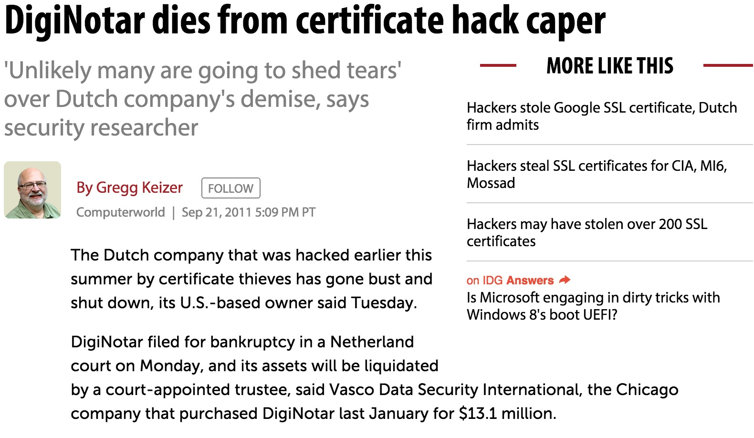
HTTPS / TLS CA #fail: September 2011
Notes:
From Bulletproof TLS by Ivan Rystic:
TRUSTWAVE
There is the question of whether CAs themselves can be trusted to do their jobs well and for the public benefit; who are those hundreds of organizations that we allow to issue certificates with little supervision? The fear that they might put their commercial interests above our security needs is sometimes justified. For example, in 2012 Trustwave admitted to issuing a subordinate certificate that would be used for traffic inspection, forging certificates for any web site on the fly. Although Trustwave is the only CA to publicly admit to issuing such certificates, there were rumors that such behavior was not uncommon.
Many fear that governments abuse the system to allow themselves to forge certificates for arbitrary domain names. Can we really be sure that some of the CAs are not just fronts for government operations? And, even if they are not, can we be sure that they can’t be compelled to do whatever their governments tell them to? We can’t. The only unknown is the extent to which governments will interfere with the operation of commercial CAs.

Slide 32
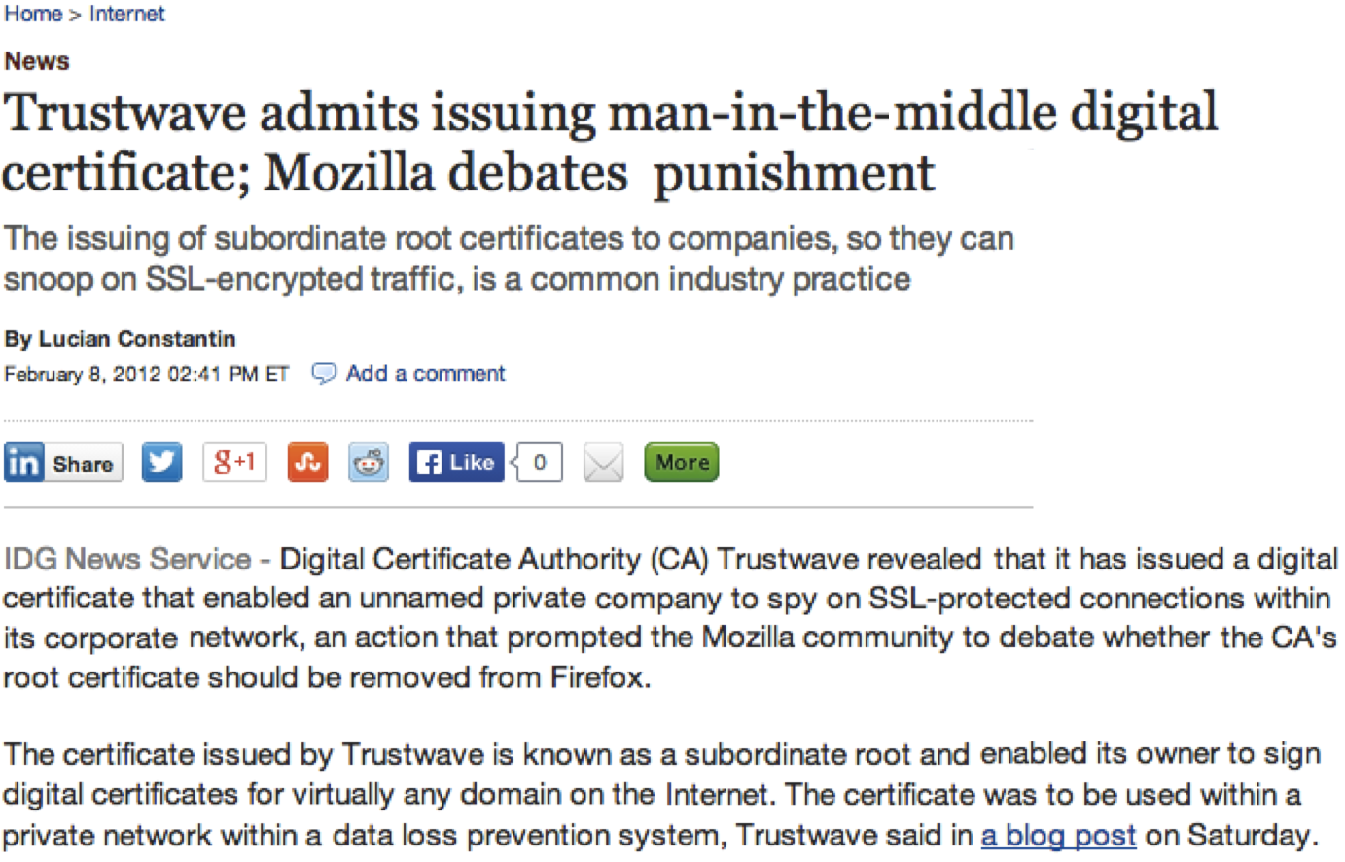
HTTPS / TLS CA #fail: February 2012
Notes:
From Bulletproof TLS by Ivan Rystic:
TRUSTWAVE
There is the question of whether CAs themselves can be trusted to do their jobs well and for the public benefit; who are those hundreds of organizations that we allow to issue certificates with little supervision? The fear that they might put their commercial interests above our security needs is sometimes justified. For example, in 2012 Trustwave admitted to issuing a subordinate certificate that would be used for traffic inspection, forging certificates for any web site on the fly. Although Trustwave is the only CA to publicly admit to issuing such certificates, there were rumors that such behavior was not uncommon.
Many fear that governments abuse the system to allow themselves to forge certificates for arbitrary domain names. Can we really be sure that some of the CAs are not just fronts for government operations? And, even if they are not, can we be sure that they can’t be compelled to do whatever their governments tell them to? We can’t. The only unknown is the extent to which governments will interfere with the operation of commercial CAs.

Slide 33
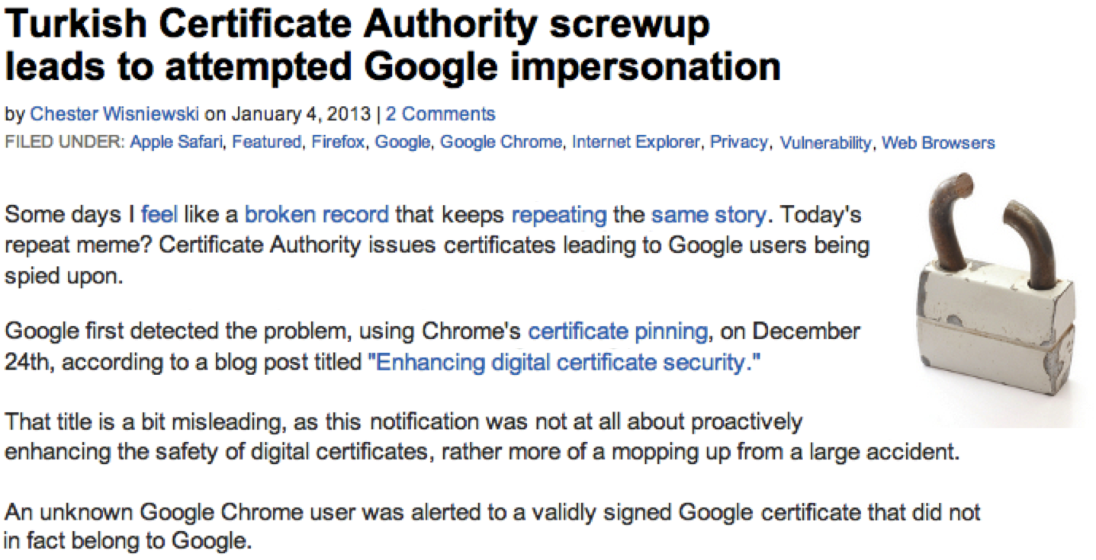
HTTPS / TLS CA #fail: December 2012
Notes:
From Bulletproof TLS by Ivan Rystic:
TURKTRUST
In December 2012, Google uncovered another serious PKI problem thanks to the public key pinning mechanism supported by the Chrome browser. Pinning is a mechanism that allows user agents to check that only authorized CAs are issuing certificates for specific web sites. Chrome ships with a small, hardcoded list of sites, but they are some of the most visible sites in the world.
In December 2012, when a Chrome user encountered a certificate that did not match with the hardcoded built-in list, their browser communicated the entire offending certificate chain back to Google. With access to the chain, they were able to link the rogue certificate to TURKTRUST, a Turkish certification authority.
The invalid subordinate certificates were promptly revoked by all parties. TURKTRUST published a detailed report only a couple of days later and continued to provide regular up- dates.
We learned that a mistake had been made in transition between two system installations, causing two certificates issued on that day to be marked as CA certificates. The mistake remained undetected for about 15 months, during which time the certificates were used as humble server certificates.
At some point in December 2012, a firewall with MITM capabilities was installed at EGO, one of the two organizations in possession of a misissued subordinate CA certificate. A con- tractor imported the certificate into the firewall, which started to perform its MITM func- tion by generating fake web site certificates on demand. In the process, a clone of one of Google’s certificates was made and used and subsequently detected by Chrome.
It’s not clear if the contractor knew that the certificate in question was a CA certificate. If you’re troubleshooting a MITM device and you are not familiar with PKI, importing any valid certificate you have sitting around seems like a thing that you might try.
The browser root store operators accepted TURKTRUST’s position that the incident was the result of an administrative error. There was no evidence of attack against the CA; fake certificates were not seen outside EGO’s own network. Mozilla asked TURKTRUST to undergo an out-of-order audit, and Google and Opera decided to stop recognizing TURKTRUST’s EV certificates.

Slide 34
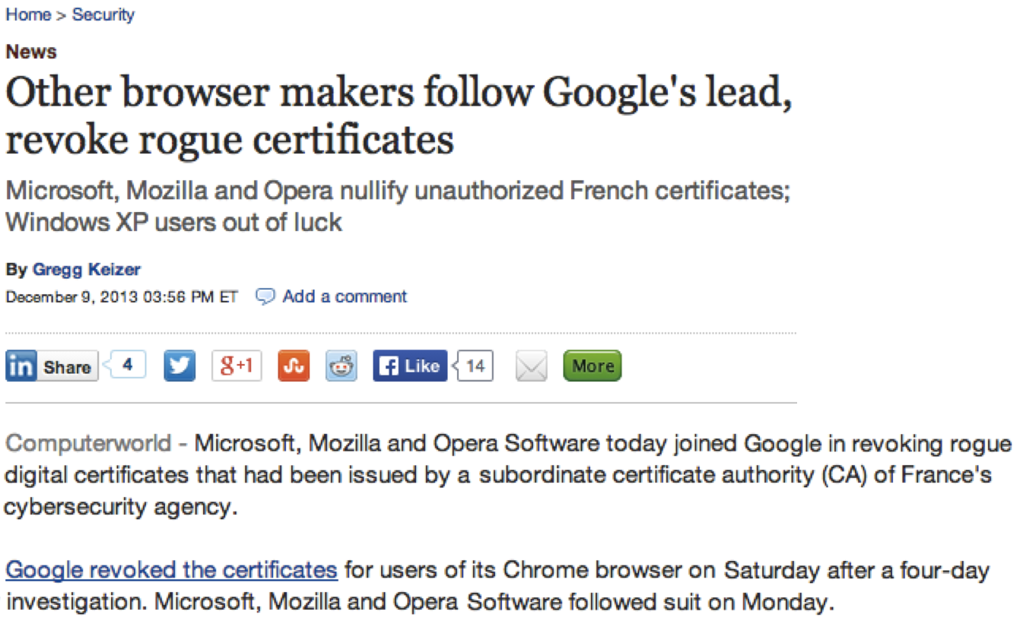
HTTPS / TLS CA #fail: December 2013
Notes:
From Bulletproof TLS by Ivan Rystic:
ANSSI
In December 2013, Google announced that Chrome was revoking trust in a subordinate CA certificate issued by ANSSI (Agence nationale de la sécurité des systèmes d’information), a French network and information security agency. A few days later, the trust in the parent ANSSI certification authority was restricted to allow only certificates issued for the domain names corresponding to French territories (.fr being the main such top-level domain name).
The reason for the revocation was the discovery that the subordinate CA certificate had been used in a transparent interception (man-in-the-middle) device running on the agen- cy’s network. As a result, certificates for various domain names were generated, some of which belonged to Google. Once again, Chrome’s pinning of Google’s certificate detected a misuse of the PKI.
Mozilla and Microsoft also disabled the offending CA certificate. The agency issued a brief statement blaming human error for the problem. There’s been no evidence that the in- appropriate certificate was used anywhere outside the network of the French Treasury.
As is usually the case, a discussion followed on mozilla.dev.security.policy.
In addition to more details of the incident being provided, various other problems with how ANSSI used the CA certificate were uncovered. For example, many of their certificates did not include any revocation information. Unusual activity was detected on their CRLs, with thousands of certificates suddenly appearing on previously empty lists. It’s not clear if and how the incident concluded. According to their own admission, ANSSI will be unable to comply with Baseline Requirements until at least December 2017, which is two years after Mozilla’s deadline.

Slide 35
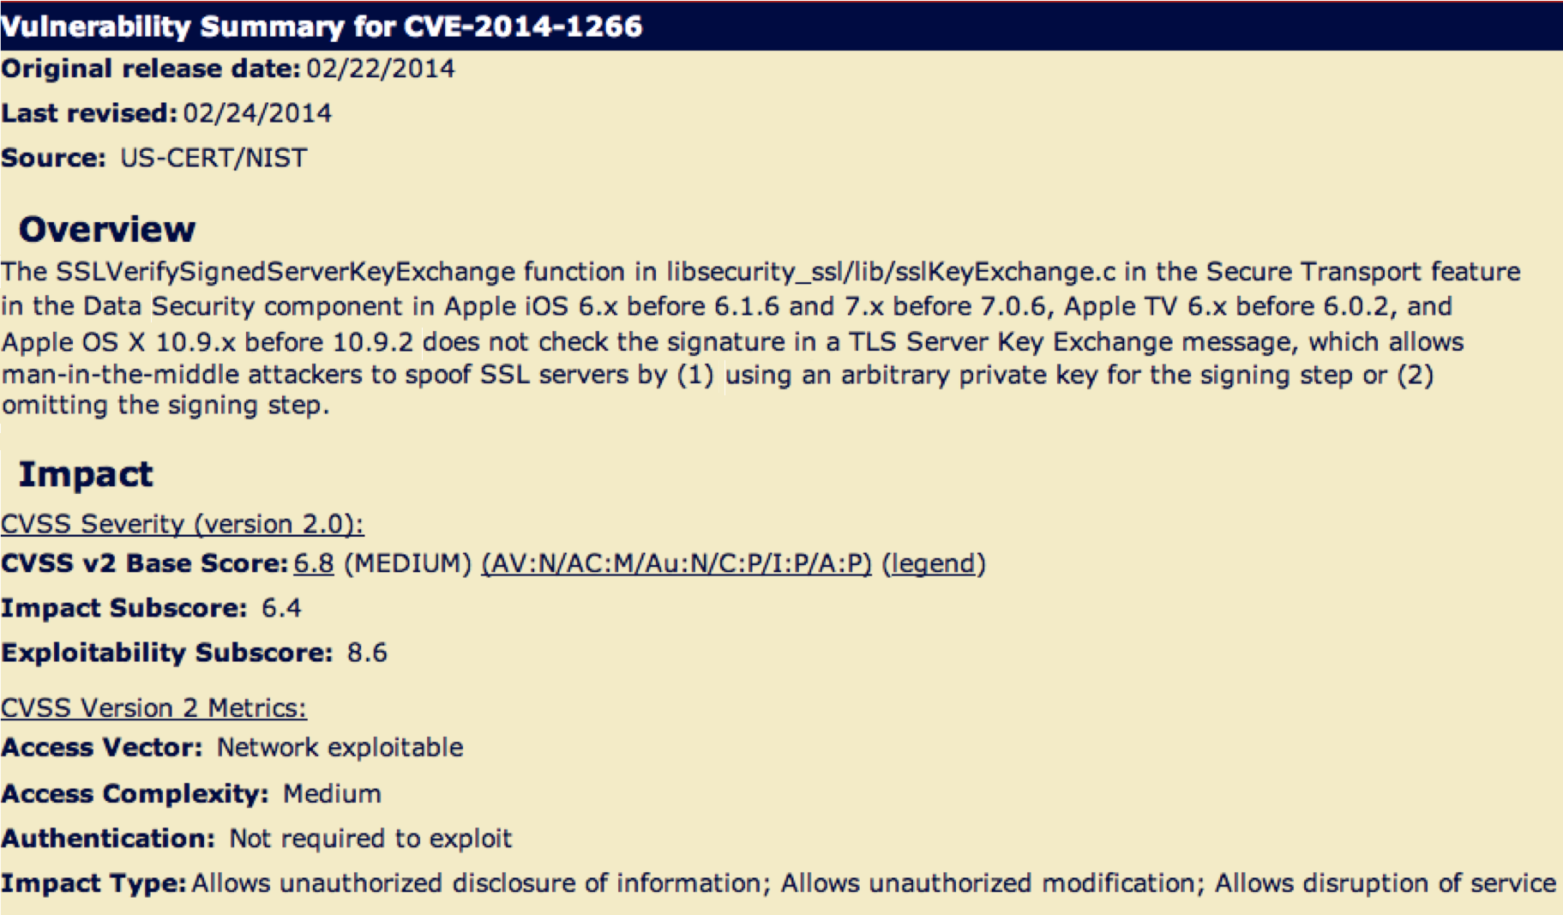
Browser / OS TLS SINS: February 2014
Notes:
From Bulletproof TLS by Ivan Rystic:
Connection authentication failure in iOS and OS X (2014)
On 21 February 2014, Apple released updates for iOS 6.x and 7.x in order to fix a bug in TLS connection authentication. Although Apple didn’t provide any details (they never do), the description caught everyone’s attention and sparked a large-scale hunt for the bug. It turned out that a devastating slip in the connection authentication code allowed any DHE and ECDHE connection to be silently hijacked by an active MITM. The bug was also found to exist in the latest version of OS X (10.9), which had been released in October 2013. Unfortunately, a fix was not immediately available; it’s not clear why Apple would choose not to synchronize releases for such a significant security issue. Possibly because of a strong backlash, the fix (OS X 10.9.2) came only a couple of days later, on February 25th.
In the context of TLS authentication, this bug is as bad as they get. The weakness is in a transient part of the handshake that is never logged. (If you were to attack certificate authentication, for example, you would need to provide a fraudulent certificate chain, which might be recorded and reported.) If proper care is taken to use it only against vulnerable clients (which should be possible, given that the TLS handshake exposes enough information to allow for pretty reliable fingerprinting), an attack could be reliable, silent, and effective without leaving any trace.
All applications running on the vulnerable operating systems were exposed to this problem. The only exceptions were cross-platform applications (for example, Chrome and Firefox) that rely on their own TLS stack.

Slide 36
Apple goto #fail SSL / TLS bug
Major iOS/OSX SSL implementation bug
http://web.nvd.nist.gov/view/vuln/detail?vulnId=CVE-2014-1266
"...does not check the signature in a TLS Server Key Exchange message....”
"...allows man-in-the-middle attackers to spoof SSL servers by (1) using an arbitrary private key for the signing step or (2) omitting the signing step.”

Slide 37


"goto fail" Apple SSL / TLS bug
static OSStatus
SSLVerifySignedServerKeyExchange(SSLContext *ctx, bool isRsa, SSLBuffer signedParams, uint8_t *signature, UInt16 signatureLen)
{
OSStatus err;
…
if ((err = SSLHashSHA1.update(&hashCtx, &serverRandom)) != 0)
goto fail;
if ((err = SSLHashSHA1.update(&hashCtx, &signedParams)) != 0)
goto fail;
goto fail;
if ((err = SSLHashSHA1.final(&hashCtx, &hashOut)) != 0)
goto fail;
…
fail:
SSLFreeBuffer(&signedHashes);
SSLFreeBuffer(&hashCtx);
return err;
}

Slide 38
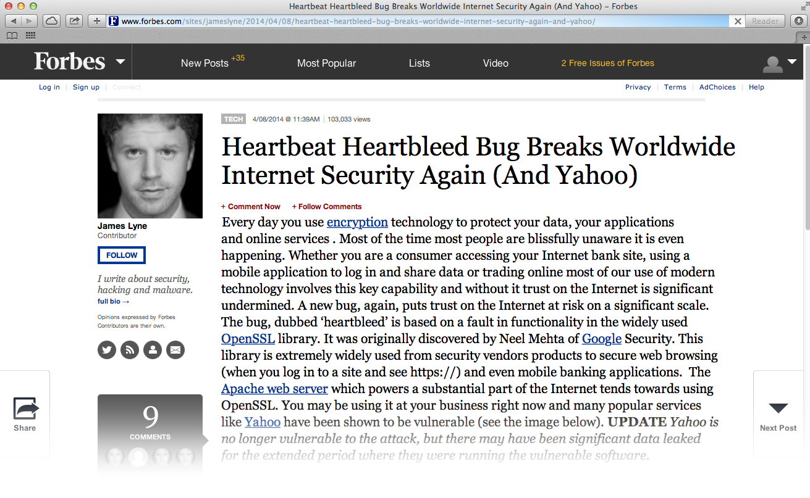
OpenSSL Sins: Heartbleed 2014

Slide 39
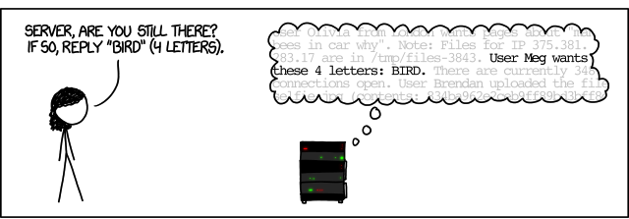
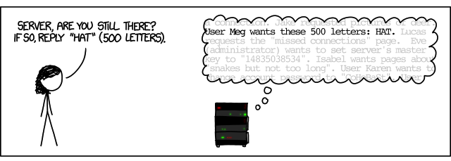
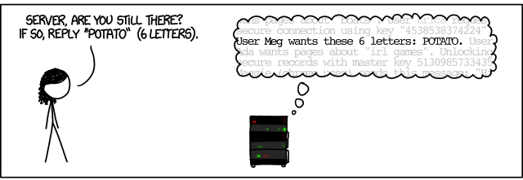
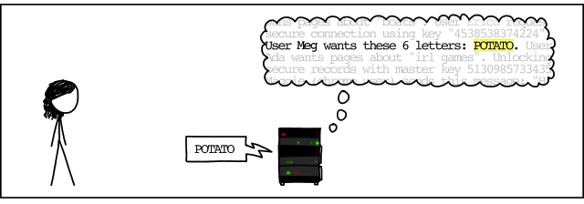
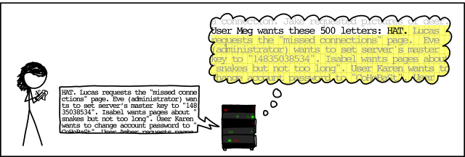
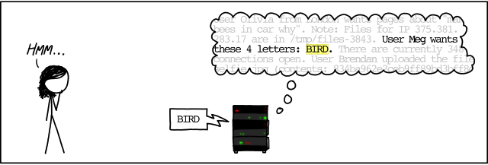
How Heartbleed works
Authored by XKCD!

Slide 40
HTTPS Progress

Slide 41
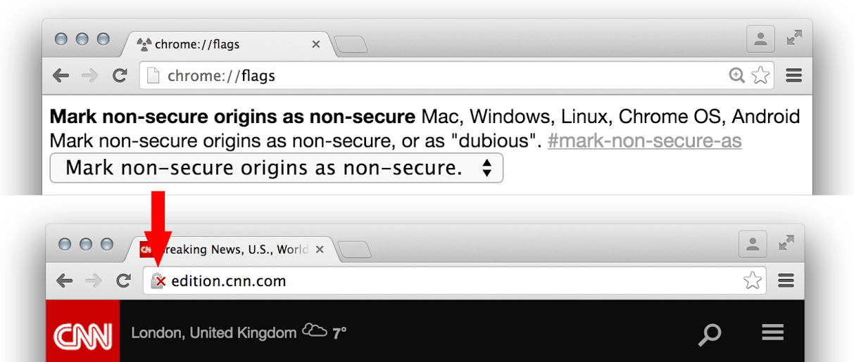
Chrome will begin to mark HTTP sites as insecure
HTTP will soon be downgraded as insecure in Chrome.
  As of December 2014, Chromes Canary release (alpha release)
  includes an option to mark HTTP websites as insecure. This will go live in 2017.

Slide 42
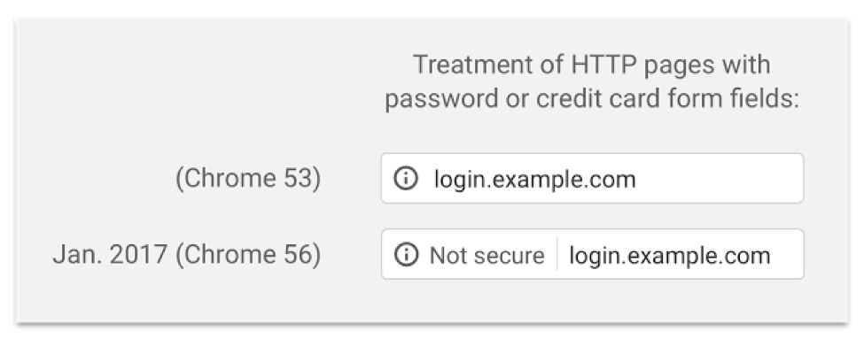
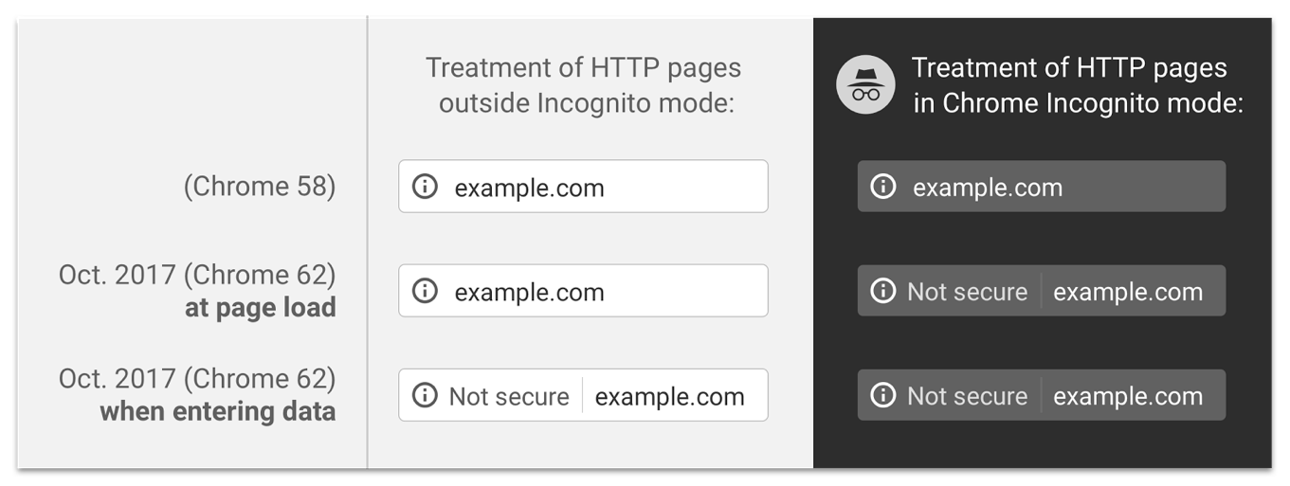
Chrome 62 in October 2017
Will mark ALL Incognito HTTP sites as insecure

Slide 43
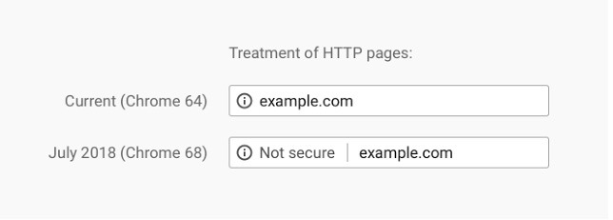
Chrome 68 in July 2018
Will mark ALL HTTP sites as insecure

Slide 44
Chrome Revokes Symantec's Authority
Symantec once owned and ran four major certificate authorities
  Symantec
  GeoTrust
  Thawte
  RapidSSL
All Symantec certificates are being revoked that were created on Symantec's older certificate creation infrastructure
Revocation Timeline
  October 2017/Chrome 62 Chrome DevTools will start alerting when receiving certificates from Symantec that will be revoked in Chrome 66.
  April 2018/Chrome 66 All Symantec certificates created before June 1, 2016 will no longer be trusted by Chrome (ie: old Symantec infrastructure)
  October 2018/Chrome 70 All symantec certificates created on Symantecs older infrastructure no longer be trusted by Chrome

Slide 45
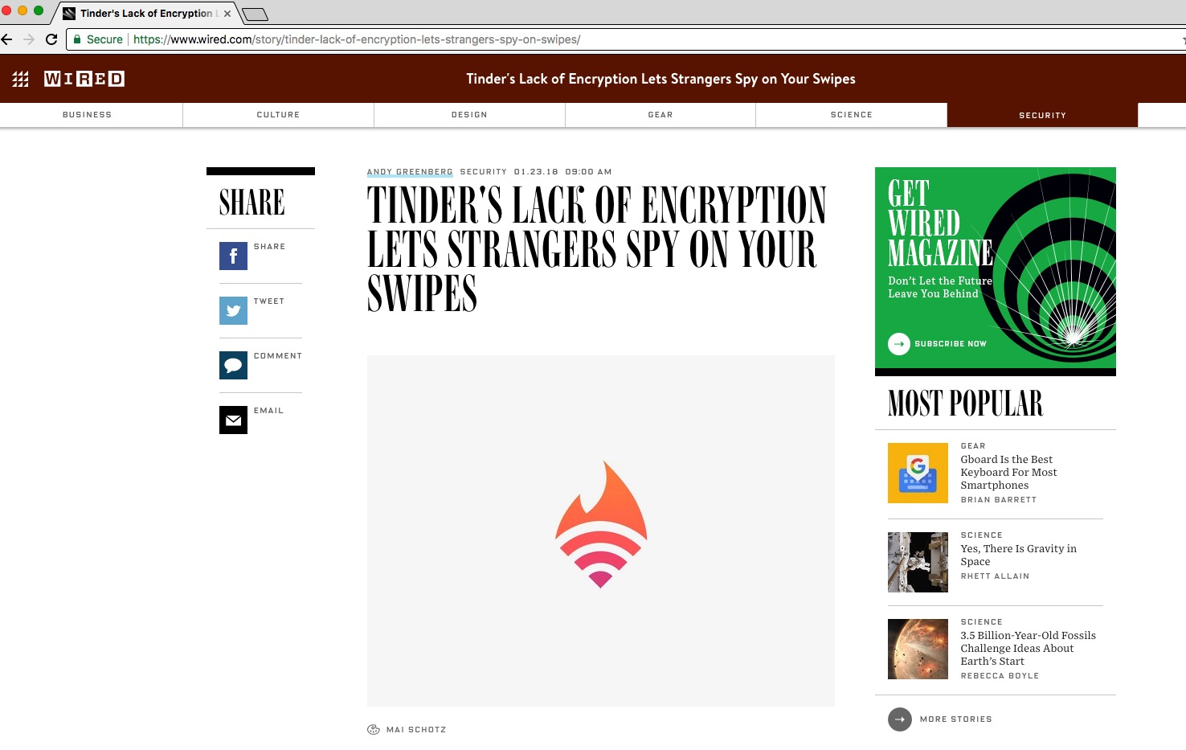

Slide 46

Excuses to avoid supporting HTTPS
Aren't certificates expensive/difficult to obtain?
The "Let's Encrypt" project will make it easy to obtain free certs for as many (sub)domains as desired!
Isn't SSL/TLS slow?
https://istlsfastyet.com/
Doesn't HTTPS break caching? Filtering?
For environments that need tight control of internet access, there are several client-side/network solutions.
https://www.chromium.org/Home/chromium-security/marking-http-as-non-secure
My site not that important
HTTPS is no longer just for security. It's a critical part of user experience. (Geolocation, AppCache, getUserMedia() and PUSH notifications)
thegameoffitness.com

Slide 47
Improving HTTPS
HSTS (Strict Transport Security)
http://www.youtube.com/watch?v=zEV3HOuM_Vw
Strict-Transport-Security: max-age=31536000
Forward Secrecy
https://whispersystems.org/blog/asynchronous-security/
Mozilla Recommended TLS Security Configurations
https://wiki.mozilla.org/Security/Server_Side_TLS#Recommended_configurations
Mozilla SSL Configuration Generator
https://mozilla.github.io/server-side-tls/ssl-config-generator/
NIST Guidelines on selection, configuration and use of TLS
https://www.nist.gov/publications/guidelines-selection-configuration-and-use-transport-layer-security-tls-implementations?pub_id=915295
Certificate Pinning
https://www.owasp.org/index.php/Pinning_Cheat_Sheet

Slide 48
HSTS
HTTP Strict Transport Security

Slide 49
About HSTS
Released in November 2012
Mitigates
  Downgrade to HTTP attacks
  MitM attack using DNS trickery
  Browser default behavior of trying HTTP first
  Mixed content
Protects the user, not the website
HTTPS specific and must own the domain
Strict-Transport-Security: max-age=31536000; includeSubDomains
Notes:
HTTP Strict Transport Security (HSTS) is a relatively new standard that enforces encryption on the hostname for which it is enabled. Optionally, it can enforce encryption on all subdomains. With this approach, a MitM attacker cannot inject any cookies using DNS trickery, because encryption would be required (and we're assuming that the MITM attacker cannot forge your certificates; if he can, you have bigger problems). HSTS significantly reduces the attack surface, but it is not foolproof. First, it's not supported by all browsers. Second, It does not handle cases in which genuine (encrypted) related sites are compromised or run by different, untrusted entities.
Tool: add site to the HSTS preloaded list: https://hstspreload.appspot.com/
Released November 2012
MitM attack mitigation is a SIGNIFICANT reason to use it.
Treating all cert errors as fatal
Protects the user. If your site is hacked, it won’t do any good to you!
HSTS is HTTP specific (pinning is not)
HSTS address the following problems
No way of knowing if a site supports TLS (site default to plain text)
Tolerance of cert problems (if a cert is invalid, it will warn and let the used continue)
Mixed content issues
Cookie Security (attackers can steal cookies even when available only under TLS)
To support HSTS, all that is needed is to include a header like this in all encrypted HTTP responses:
Strict-Transport-Security: max-age=31536000; includeSubDomains
This will make the compliant browser activate HSTS for the duration of the retention period specified in the max-age parameter across ALL PORTS.

Slide 50

HTTP Strict Transport Security (HSTS)
HSTS (Strict Transport Security)
  http://www.youtube.com/watch?v=zEV3HOuM_Vw
  Strict-Transport-Security:
  max-age=31536000; includeSubdomains;
Forces browser to only make
HTTPS connection to server
Must be initially delivered
over a HTTPS connection

Slide 51
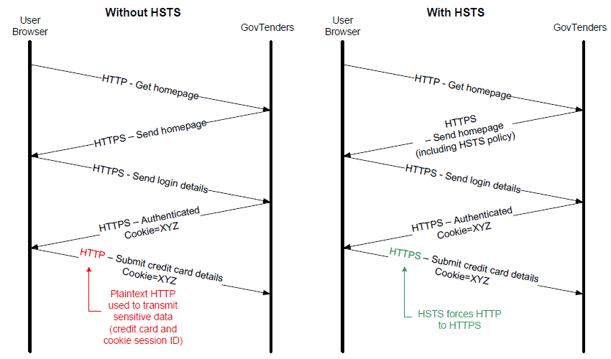
Example of HSTS in action
Reference: http://www.asd.gov.au/publications/protect/protecting_web_apps.htm

Slide 52
HSTS: Preload list
To add your site that you would like to see included in the preloaded HSTS list visit: https://hstspreload.org/
Current HSTS Chrome preload list: https://chromium.googlesource.com/chromium/src/+/master/net/http/transport_security_state_static.json
A site is included in the Firefox preload list if the following hold:
  Serve a valid certificate.
  Redirect from HTTP to HTTPS on the same host, if you are listening on port 80.
  Serve all subdomains over HTTPS.
  The max-age must be at least 31536000 seconds (1 year).
  The includeSubDomains directive must be specified.
  The preload directive must be specified.
  If you are serving an additional redirect from your HTTPS site, that redirect must still have the HSTS header.
Need to remove yourself form the list? https://hstspreload.org/removal/
Strict-Transport-Security: max-age=31536000; includeSubDomains; preload

Slide 53
HSTS Tips…
Won’t work
with self
signed certs
Won’t work with IP
Won’t work with plaintext connection
Deploy with a short duration value first. Increase it later.
Will work with
all ports
To revoke HSTS:
Strict-Transport-Security: max-age=0
Notes:
Testing warning: This will not work on self signed certs! (it would defeat the DNS trickery if it did)
You cannot use it on IP addresses either. (IPs can be dynamic…)
The header cannot be seen on plaintext connection (this is to avoid a DoS attack).
If you use HTTP and HTTPS for the same site, do a permanent redirect (301 status code) instead to the HTTPS site.
Deployment: Star with a short duration value. Increase it later.
If you use more than one host name (e.g. mail.site.com and blog.site.com) you need to activate it in all hostnames. This is to prevent the case where a user may visit on host but not the other one that is protected.
To revoke HSTS, set the max age to 0
Strict-Transport-Security: max-age=0
The revocation only happens when a browser that visited the site visits it again.

Slide 54

HSTS Security Considerations
Include in all subdomains, even when using includeSubDomains
  Lack of includeSubDomains is a privacy violation for users.
Back to first use scenario once retention period expires.
  Can be forced to first use scenario by spoofing NTP
Does not necessarily secure cookies
  Redirect to a made-up subdomain may reveal cookies (assuming no https)
  Continue to use secure cookies
Notes:
Attacks
HSTS is activated during the fist use, until then it's still vulnerable. A browser can preload the HSTS. This is still possible since the list is small.
HSTS is valid until the retention period expires. If it expires before the user visits the site again, the user is back to the potentially vulnerable "first use" scenario. Another cool way to make the retention expire is to spoof the NTP (network time protocol) server to a time in the future.
HTST does not make secure cookies obsolete. An attacker can still steal cookies by capturing them from www.site.com and sending them to madeup.www.site.com, assuming he can create this http site and manipulate DNS.

Slide 55
HSTS Supported Browsers
Minimum Browser Support
Internet Explorer 11 Or Edge
Firefox 29
Opera 12
Safari 7
Android Browser 4.4 (KitKat)
Chrome

Slide 56
Perfect Forward Secrecy

Slide 57

Perfect Forward Secrecy
If you use older SSL ciphers, every time anyone makes a SSL connection to your server, that message is encrypted with (basically) the same private server key
Perfect forward secrecy: Peers in a conversation instead negotiate secrets through an ephemeral (temporary) key exchange
With PFS, recording ciphertext traffic doesn’t help an attacker even if the private server key is stolen!
https://whispersystems.org/blog/asynchronous-security/

Slide 58
SSL / TLS Ciphers
Forward Secrecy
  TLS_ECDHE_RSA_WITH_AES_256_GCM_SHA384 (0xc030)
  TLS_ECDHE_RSA_WITH_AES_128_GCM_SHA256 (0xc02f)
  TLS_ECDHE_RSA_WITH_AES_128_CBC_SHA256 (0xc027)
  TLS_ECDHE_RSA_WITH_AES_128_CBC_SHA (0xc013)
  TLS_ECDHE_RSA_WITH_AES_256_GCM_SHA384 (0xc030)
  TLS_ECDHE_RSA_WITH_AES_256_CBC_SHA384 (0xc028)
  TLS_ECDHE_RSA_WITH_AES_256_CBC_SHA (0xc014)
NOT Forward Secrecy
  TLS_RSA_WITH_AES_128_GCM_SHA256 (0x9c)
  TLS_RSA_WITH_AES_128_CBC_SHA256 (0x3c)
  TLS_RSA_WITH_AES_128_CBC_SHA (0x2f)
  TLS_RSA_WITH_AES_256_GCM_SHA384 (0x9d)

Slide 59
Cipher Suite Explained
Asymmetric
Symmetric
CIPHER
TLS_ECDHE_RSA_WITH_AES_128_GCM_SHA256
KEY EXCHANGE
AUTHN
ENCRYPTION
LEN
MODE
MAC
TLS_RSA_WITH_AES_128_CBC_SHA
KEY EXCHANGE + AUTHN
ENCRYPTION
LEN
MODE
MAC
KX | AuthN | Encryption | MAC | PRF
RSA | RSA | AES | SHA256 | SHA256
ECDHE | ECDSA | RC4 | SHA1 | SHA384
DHE | DSS | 3DES | MD5 | Protocol*
★
⬇
★
★
⬆
⬆
★
LEGEND
★ Popular
⬇ Phase Out
⬆ NIST std
⬆
⬆
⬇
⬇
⬇
GCM
CBC
⬆
⬇
Notes:
IVAN: Technically, there's nothing wrong with MD5 and SHA1 MACs; there's no known attack vectors on HMAC, even when used with MD5.
IVAN TODO: - However, you should recommend AEAD suites over CBC here. That's important.
Naftuli Kay
Introduction to Cryptography by Christof Paar – Videos and Books on Crypto.
Stress out the fact that asymmetric algorithms are ONLY used for the handshake. Lots of people don’t realize this. Also mention asymmetric algorithms are NOT more secure than symmetric.
Tool: Test TLS implementation http://ssllabs.com
GCM and CCM (Authenticated Ciphers) do encryption and integrity validation in one algorithm. This is why no MAC is specified, only PRF.
90% of websites that use SSL encryption — — use an algorithm called SHA-1 to protect themselves from being impersonated
SHA1: https://konklone.com/post/why-google-is-hurrying-the-web-to-kill-sha-1
Test SHA1: https://shaaaaaaaaaaaaa.com/
AuthN: Authentication
RSA: Rivest, Shamir, Adleman
ECDSA: Elliptic Curve Digital Signature Algorithm
DSS: Digital Signature Standard
KX
ECDHE: Eliptic Curve Diffie Hellman Ephemeral
DHE: Diffie Helmman Ephemeral
AES: Advanced Encryption Standard
PRF: Pseudo Random Function
List of Cipher Suite supported by a browser: https://cc.dcsec.uni-hannover.de/

Slide 60
Mobile Certificate Pinning

Slide 61



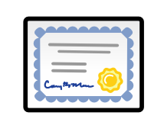



In God We Trust
Cert Auth
Cert Auth
Cert Auth
Cert Auth
Notes:
Any CA can issue certificates for any site!
CA's job is to provide certs for domain owners but not to other people...
But the domain owner is not required to authorize certificate issuance!
There are hundreds of CA and possibly thousands of entities who influence cert insurance (e.g. whois, email)

Slide 62
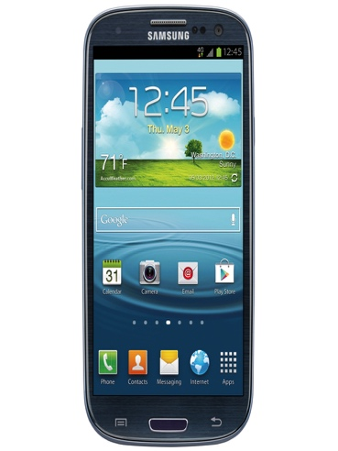


In God We Trust
Validates cert
App Talks to Server
Cert Auth
Cert Auth
Cert Auth
Cert Auth
Cert Store
Notes:
Any CA can issue certificates for any site!
CA's job is to provide certs for domain owners but not to other people...
But the domain owner is not required to authorize certificate issuance!
There are hundreds of CA and possibly thousands of entities who influence cert insurance (e.g. whois, email)

Slide 63

In God We Trust
Cert Auth
Cert Auth
Cert Auth
Cert Auth
App Talks to Evil Server
Cert Store
Can Certificate authorities be breached?
Comodo
VeriSign
DigiNotar
Notes:
Any CA can issue certificates for any site!
CA's job is to provide certs for domain owners but not to other people...
But the domain owner is not required to authorize certificate issuance!
There are hundreds of CA and possibly thousands of entities who influence cert insurance (e.g. whois, email)

Slide 64

In God We Trust and maybe some Certificate Authorities…
Validates cert
Cert Auth
Cert Auth
Cert Auth
App Talks to Evil Server
Evil
Cert Auth
Cert Store
Notes:
Any CA can issue certificates for any site!
CA's job is to provide certs for domain owners but not to other people...
But the domain owner is not required to authorize certificate issuance!
There are hundreds of CA and possibly thousands of entities who influence cert insurance (e.g. whois, email)
Gmail for iOS was a victim: http://www.lacoon.com/blog/2014/07/security-disclosure-googles-ios-gmail-app-enables-threat-actor/

Slide 65

Pinning: Trust On First Use (TOFU) example
Validates cert
App Talks to Server
Cert Auth
Cert Store
Notes:
For those familiar with SSH, you should realize that public key pinning is nearly identical to SSH's StrictHostKeyChecking option. SSH had it right the entire time, and the rest of the world is beginning to realize the virtues of directly identifying a host or service by its public key.
Pinning reduces the attack surface for certificate forgery. Only possible via a proprietary mechanism in Chrome (and Android). Standards are upcoming and include DANE (based on DNSSec), Public Key Pinning for HTTP and TACK.

Slide 66
Pinning: Reduces the attack surface for cert forgery
App Talks to Server
Cert Auth
Evil
Cert Auth
Notes:
Because we don’t need to go back to the CA, the previous threat of an evil or compromised CA is no longer a problem.
In fact the mobile App can come with the cert already pinned during the installation. This out of band approach mitigates the threat of a compromised connection on first use.
Chrome was successful in detecting the DigiNotar compromise which uncovered suspected interception by the Iranian government on its citizens. The initial report of the compromise can be found at Is This MITM Attack to Gmail's SSL.

Slide 67
What is Certificate Pinning?
Pinning is a key continuity scheme, detecting when an imposter with
a fake, but properly CA signed certificate attempts to act like the real server.
There are two types of pinning:
https://www.owasp.org/index.php/Pinning_Cheat_Sheet
Carry around a copy of the server’s public key
  Great if you are distributing a dedicated client-server application
  since you know the server’s certificate or public key in advance
Note of the server’s public key on first use;
Trust-on-First-Use (TOFU) pinning
  Useful when no a priori knowledge exists, such as SSH or a Browser.
Notes:
Pinning is a key continuity scheme, and the idea is to either (1) carry around a copy of the server’s public key; or (2) note of the server’s public key on first use (Trust-on-First-Use, Tofu). The former is great if you are distributing a dedicated client-server application since you know the server’s certificate or public key in advance. The latter is useful when no a priori knowledge exists, such as SSH or a Browser. Both detect the unexpected change that occurs when an imposter with a fake certificate attempts to act like the real server.
While you have a choice to pin the certificate or public key, it’s often best to pin the public key. That is because some companies, such as Google, rotate its certificate regularly (every 30 days or so) but re-certifies the inner public key.

Slide 68
Pinning Options: What to Pin
Certificate Pinning: Intermediate cert, Root cert
Public Key Pinning (may cover more certs):
subjectPublicKeyInfo, RSAPublicKey, DSAPublicKey
Hash of the options above
Notes:
IVAN: In all cases you'll be pinning SPKI, note certificates. Unless you're also covering mobile applications, in which case you can actually pin certificates. But even when you have full control, SPKI pinning is more flexible.
SPKI – Simple Public Key Infrastructure (spoo-key)
The first thing to decide is what should be pinned. For this choice, you have two options: you can (1) pin the certificate; or (2) pin the public key. If you choose public keys, you have two additional choices: (a) pin the subjectPublicKeyInfo; or (b) pin one of the concrete types such as RSAPublicKey or DSAPublicKey. I would encourage you to pin the subjectPublicKeyInfo because it has the public parameters (such as {e,n} for an RSA public key) and contextual information such as an algorithm and OID.
What to Pin?
Certs and public keys are the usual candidates for pinning. There is no need to store the entire cert. A hash (SHA256) is shorter and easier to handle.
Public key pinning is more practical. Certs sometimes are reissued without changing the public key. It's also common to see several certs with the same public key (so there is less to pin as it will work with all associated certs)
Issue:
server keys should be rotated frequently. In addition, if a server is compromised and replaced, old pin will no longer be valid. Pinning the intermediate cert or the root CA cert requires fewer changes. The best candidate is the second cert in the chain. This approach ensure that the pinned public key is always in the chain. It also give you agility: if you are not happy with your CA, you can get a different intermediate cert (using the same private key) from someone else.

Slide 69
Pinning: Considerations
Always have a backup pin and a spare certificate from a different CA
  Avoids a self inflicted DoS
  Consider setting the pin in days if trust on first use (TOFU, aka key continuity)
  Certificates should have overlapping validity periods
For Mobile Apps, consider adding the pinning during install instead of TOFU
  Out of band pinning decreases chances of attacker tainting pin
Pinning makes it harder to Pen Test
  May need to use iOS SSL/TLS Kill Switch and Android SSL/TLS Bypass Tool
  May need to disable it altogether
Notes:
overlapping validity periods: help to update application without incurring down time
Important: Always have a backup pin and a spare certificate from a different CA.
Issue to avoid: what happens if you loose the identity you pinned? This becomes a self inflicted DoS. For this reason, pinning period is set in days.
A host or service's certificate or public key can be added to an application at development time, or it can be added upon first encountering the certificate or public key. The former - adding at development time - is preferred since preloading the certificate or public key out of band usually means the attacker cannot taint the pin. If the certificate or public key is added upon first encounter, you will be using key continuity (also known as Trust on first use (aka TOFU)). Key continuity can fail if the attacker has a privileged position during the first encounter.
Pinning makes it harder to pen test an application. There are ways around it. See Black Hat 2012 presentation "BH_US_12_Diqut_Osborn_Mobile_Certificate_Pinning_Slides.pdf". Two apps were created iOS SSL Kill Switch and Android SSL Bypass Tool (both available on Github)
See OWASP for examples of pinning
To view a cert public key (SKPI field):
openssl x509 -in server.crt -noout -text
See page 360 for instructions on how to generate the hash out of the public key.
Android 4.2 has limited support for pinning:
http://nelenkov.blogspot.ca/2012/12/certificate-pinning-in-android-42.html
See Public Key Pinning Extension for HTTP (pg 315). Continue from there...

Slide 70
Privately (locally installed) Certificate Authorities
"...private trust anchors can be used to proxy (or MITM) connections, even to pinned sites. 'Data loss prevention' appliances, firewalls, content filters, and malware can use this feature to defeat the protections of key pinning..."
https://www.chromium.org/Home/chromium-security/security-faq#TOC-How-does-key-pinning-interact-with-local-proxies-and-filters-
Users can be...
  Tricked into installing a CA. (ex/ to get WiFi access at a hotel)
  Forced into installing a CA as part of a BYOD program.
  Forced into installing a CA just by installing a program.
  Forced into using a CA that is preloaded by an OEM.

Slide 71
Pinning Can (and has) Been Evaded
Locally Installed Authorities can MITM while evading Pinning!
  "Researchers revealed that a vulnerability in Superfish software, which came pre-loaded
  on many Lenovo laptops, could let hackers impersonate shopping, banking and other websites and steal users' credit card numbers and other personal data.”
  — CBS News, February 2017
Even the hard-coded Pinning of Google services in Chrome were evaded
  SuperFish installs its own root CA certificate in Windows systems.
  It then generates certificates on the fly for each attempted SSL connection
  to inject advertisements.
  The private key of the Superfish pair was discovered allowing reuse.
Rapid research on this incident from the security community
  Robert Graham series of blog posts
  General Info on Superfish: http://blog.erratasec.com/2017/02/some-notes-on-superfish.htm
  Extracting Superfish certs: http://blog.erratasec.com/2017/02/extracting-superfish-certificate.html
  Exploiting Superfish:http://blog.erratasec.com/2017/02/exploiting-superfish-certificate.html
Notes:
overlapping validity periods: help to update application without incurring down time
Important: Always have a backup pin and a spare certificate from a different CA.
Issue to avoid: what happens if you loose the identity you pinned? This becomes a self inflicted DoS. For this reason, pinning period is set in days.
A host or service's certificate or public key can be added to an application at development time, or it can be added upon first encountering the certificate or public key. The former - adding at development time - is preferred since preloading the certificate or public key out of band usually means the attacker cannot taint the pin. If the certificate or public key is added upon first encounter, you will be using key continuity (also known as Trust on first use (aka TOFU)). Key continuity can fail if the attacker has a privileged position during the first encounter.
Pinning makes it harder to pen test an application. There are ways around it. See Black Hat 2012 presentation "BH_US_12_Diqut_Osborn_Mobile_Certificate_Pinning_Slides.pdf". Two apps were created iOS SSL Kill Switch and Android SSL Bypass Tool (both available on Github)
See OWASP for examples of pinning
To view a cert public key (SKPI field):
openssl x509 -in server.crt -noout -text
See page 360 for instructions on how to generate the hash out of the public key.
Android 4.2 has limited support for pinning:
http://nelenkov.blogspot.ca/2012/12/certificate-pinning-in-android-42.html
See Public Key Pinning Extension for HTTP (pg 315). Continue from there...

Slide 72
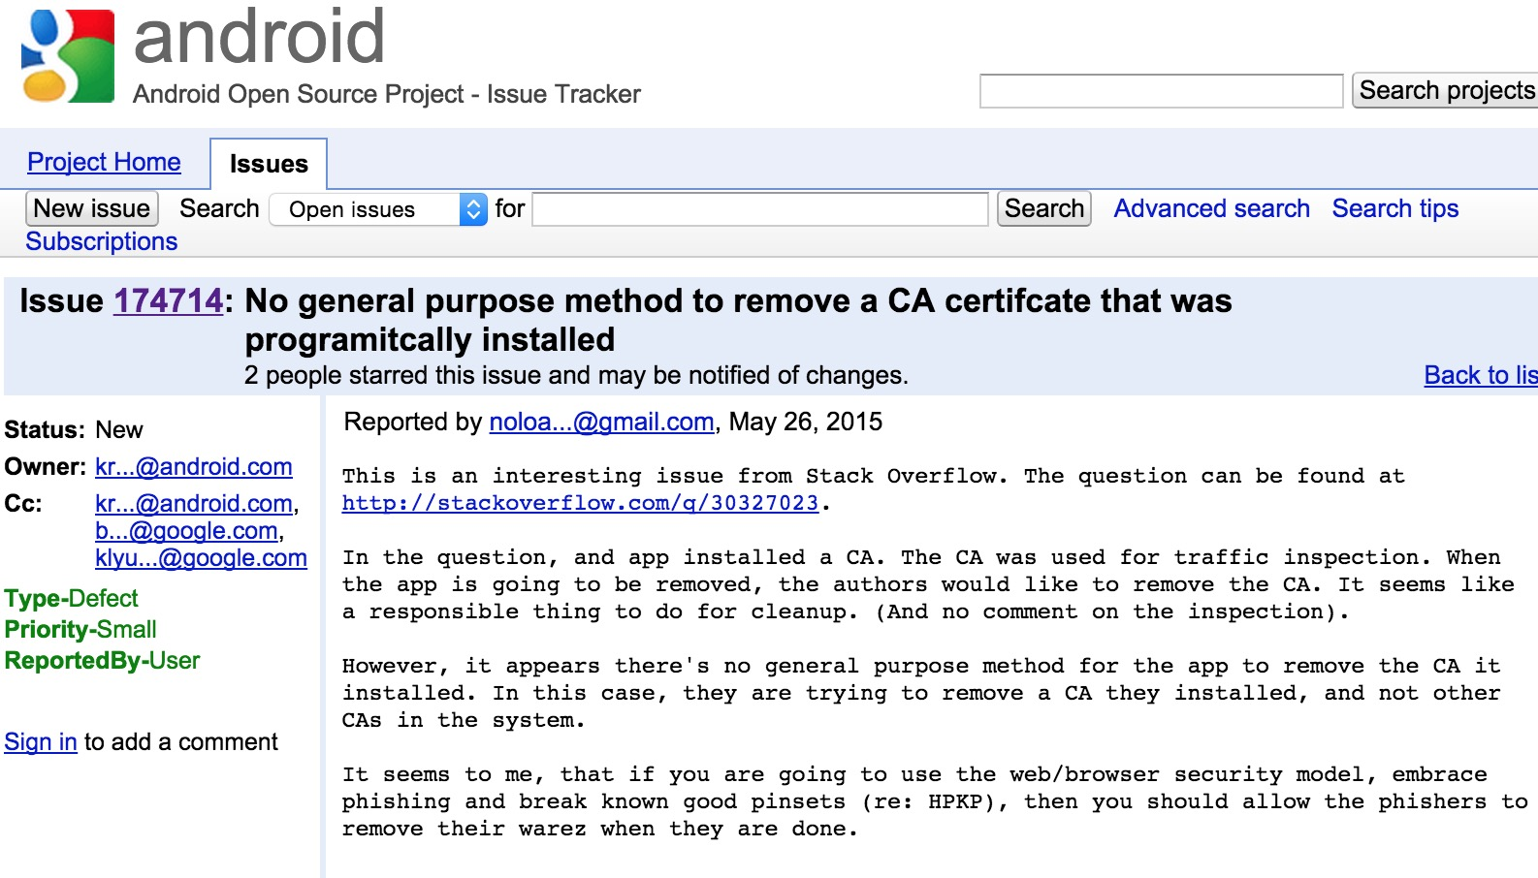
Android Sins: No clear way to remove local authority

Slide 73
Recent Advances

Slide 74

Certification Authority Authorization (CAA)
Certificate Authority Authorization (CAA) is a standard that allows domain name owners to restrict which CAs are allowed to issue certificates for their domains.
CAA can help detect malicious issuance of fradulant certificates.
September 2017: CAA became mandatory. CAs with browser root certificates must check for the CAA record and must follow the content of CAA when issuing new certificates.
The CAA record is defined in RFC 6844 https://datatracker.ietf.org/doc/rfc6844/

Slide 75

Certificate revocation doesn’t always work

Slide 76
Revocation does not work
It takes at least 10 days for the revocation Information to fully propagate
Browser soft fail policy makes revocation ineffective
OCSP request can be intercepted (more on this than later)
Most browsers ignore revocation for all certificates but EV certificates
  List includes Chrome, Firefox, Chrome on Android, iOS on Safari…
  IE and Opera do the right think checking OCSP and CRL when appropriate
  Revocation checks can be enable in some browsers.
  In Firefox, set security.ocsp.required to true
  Important certificates (e.g., intermediate CAs), rely on a proprietary revocation
  channel (CRISets) that feeds off of Cert Revocation Lists (CRL) information
Notes:
Revocation does not work
It is generally seen that revocation does not work. We saw several CA failures in 2011,
and, in every case, relying parties had to issue patches or use their proprietary black-
listing channels to reliably revoke the compromised certificates.
There are two reasons why that was necessary. First, there's a delay in propagating re-
vocation information to each system. Baseline Requirements allow CRL and OCSP in-
formation to stay valid for up to 10 days. This means that it takes at least 10 days for
the revocation Information to fully propagate. The second problem is the soft-fail pol
icy implemented in all current browsers; they will attempt to obtain revocation infor-
mation but ignore all failures. An active network attacker can easily suppress OCSP
requests, for example, allowing him to use a fraudulent certificate Indefinitely.
Because of this, Chrome developers decided to stop checking for revocation except for
EV certificates. For important certificates (e.g., intermediate CAs), they rely on a pro-
prietary revocation channel (CRISets) that feeds off of CRL information.
http://news.netcraft.com/archives/2013/05/13/how-certificate-revocation-doesnt-work-in-practice.html

Slide 77

Online Certificate Status Protocol (OCSP)
An alternative to certificate lists (CRL)
Port 80 to OCSP: Request status for webserver
Port 80 to Client: Status OK. Signed by OCSP Responder
OCSP Responder
No Privacy
Cert Auth
App Talks to Server
Does the usual…
Not shown here
for simplicity sake.
Web Server
Notes:
Online certificate status protocol
created as an alternative to certificate revocation lists (CRL) – the idea was to avoid the burden of a large CRL (Cert revocation list): it uses a lot less bandwidth. According to GoDaddy, their CRL grew from 158KB in 2007 to 41MB in 2013!
When an SSL client encounters a cert that contains OCSP information, it contacts the designated OCSP server to determine if the cert has been revoked.
The key that signs a response need not be the same key that signed the certificate.
OCSP requests are sent over HTTP
One issue with OCSP is privacy because the client must ask the CA for the OCSP information.

Slide 78

Attacks against OCSP
Port 80 to OCSP: Request status for webserver
Port 80 to Client: Status OK. Signed by OCSP Responder
OCSP Responder
MitM
Cert Auth
App Talks to Server
Does the usual…
Not shown here
for simplicity sake.
Web Server
Notes:
OCSP used to include a nonce but this didn’t scale well when caching and CDN became the norm. As a result clients don’t send nonce and if they send servers ignore them. For this reason, OCSP can be vulnerable to replay attacks, where a signed, 'good' response is captured by a malicious intermediary and replayed to the client at a later date after the subject certificate may have been revoked. The only defense is the built-in time limit.

Slide 79

Attacks against OCSP
Port 80 to OCSP: Request status for webserver
OCSP Responder
MitM
Cert Auth
OCSP Request
OCSP Request
Does the usual…
Not shown here
for simplicity sake.
Web Server
Notes:
When an SSL client encounters a cert that contains OCSP information, it contacts the designated OCSP server to determine if the cert has been revoked. Because the MiTM can suppress all the traffic to the server, this method can fail. Browsers tend to fail quietly in this case. Browsers can be configured to hard fail. In firefox go to about, config and set security.ocsp.required to true. (screen shot slide)

Slide 80

OCSP Stapling Faster, safer and more private
OCSP Responder
Caches OCSP data and staples in cert response
Cert Auth
Port 80
App Talks to Server
Does the usual…
Not shown here
for simplicity sake.
Web Server
Notes:
To overcome performance, privacy and security issues (drop package), OCSP Stapling was created. The webserver is the one to talk to the CA and obtain a fresh response. The server can then cache the OCSP info and submit it to the client along with the cert. Besides privacy, this also improves performance and resolves the man in the middle “drop package” attack seen with OCSP.
Apache supports OCSP stapling starting with the 2.4.x version.

Slide 81
SHA-1 / RC4

Slide 82
SHA-1 and the Urgency to Move On
90% of websites use SHA-1 to protect themselves from being impersonated
In 2005, cryptographers proved that SHA-1 could be
cracked 2,000 times faster than predicted
As long as browsers need to support SHA-1 for someone, anyone's certificate can be forged because browsers will not know there is a good cert that uses SHA-2
Year | Cost (In US$) | Cost Within Reach For
2012 | 2,770,000 | Government, large corporations
2017 | 700,000 | Medium size institutions
2018 | 173,000 | Organized crime
2021 | 43,000 | University research
Notes:
https://konklone.com/post/why-google-is-hurrying-the-web-to-kill-sha-1
SHA1 collision cost: Burce Schneier - https://www.schneier.com/blog/archives/2012/10/when_will_we_se.html
Website for test: https://shaaaaaaaaaaaaa.com/
You can impersonate a SHA-2-signed cert with a SHA-1-signed forgery, because the browser will only be looking at the forgery and not know that there's a "real" cert or that that cert is "supposed" to be signed with SHA-2

Slide 83



The Death of SHA-1 according to Google
Chrome Version | Date | UI Changes | Behavior
39 | Sept 2014 |  | Certs that expire in Jan 2017 using SHA-1 or mixed content
40 | Nov 2014 |  | Certs that expire between 1 June 2017 to 31 Dec 2017 using SHA-1 in the chain
41 | Q1 2017 |  | Certs that expire on or after 1 Jan 2017
Source: http://googleonlinesecurity.blogspot.com/2014/09/gradually-sunsetting-sha-1.html
Notes:
Source: http://googleonlinesecurity.blogspot.com/2014/09/gradually-sunsetting-sha-1.html

Slide 84
The Death of SHA-1 according to Mozilla
Show the “Untrusted Connection” error whenever a publically issued SHA-1 certificate issued after January 1, 2016, is encountered in Firefox.
  Locally installed authorities (like MITM proxy tools) are NOT subject to this rule.
Firefox will show the "Untrusted Connection" error message for all SHA-1-based certificates after January 2017.
https://www.fxsitecompat.com/en-CA/docs/2015/sha-1-based-certificates-with-validity-period-from-2016-will-not-be-validated/
Notes:
https://konklone.com/post/why-google-is-hurrying-the-web-to-kill-sha-1
SHA1 collision cost: Burce Schneier - https://www.schneier.com/blog/archives/2012/10/when_will_we_se.html
Website for test: https://shaaaaaaaaaaaaa.com/
You can impersonate a SHA-2-signed cert with a SHA-1-signed forgery, because the browser will only be looking at the forgery and not know that there's a "real" cert or that that cert is "supposed" to be signed with SHA-2
“CAs MAY continue to sign certificates to verify OCSP responses using SHA1 until 1 January 2017.”

Slide 85
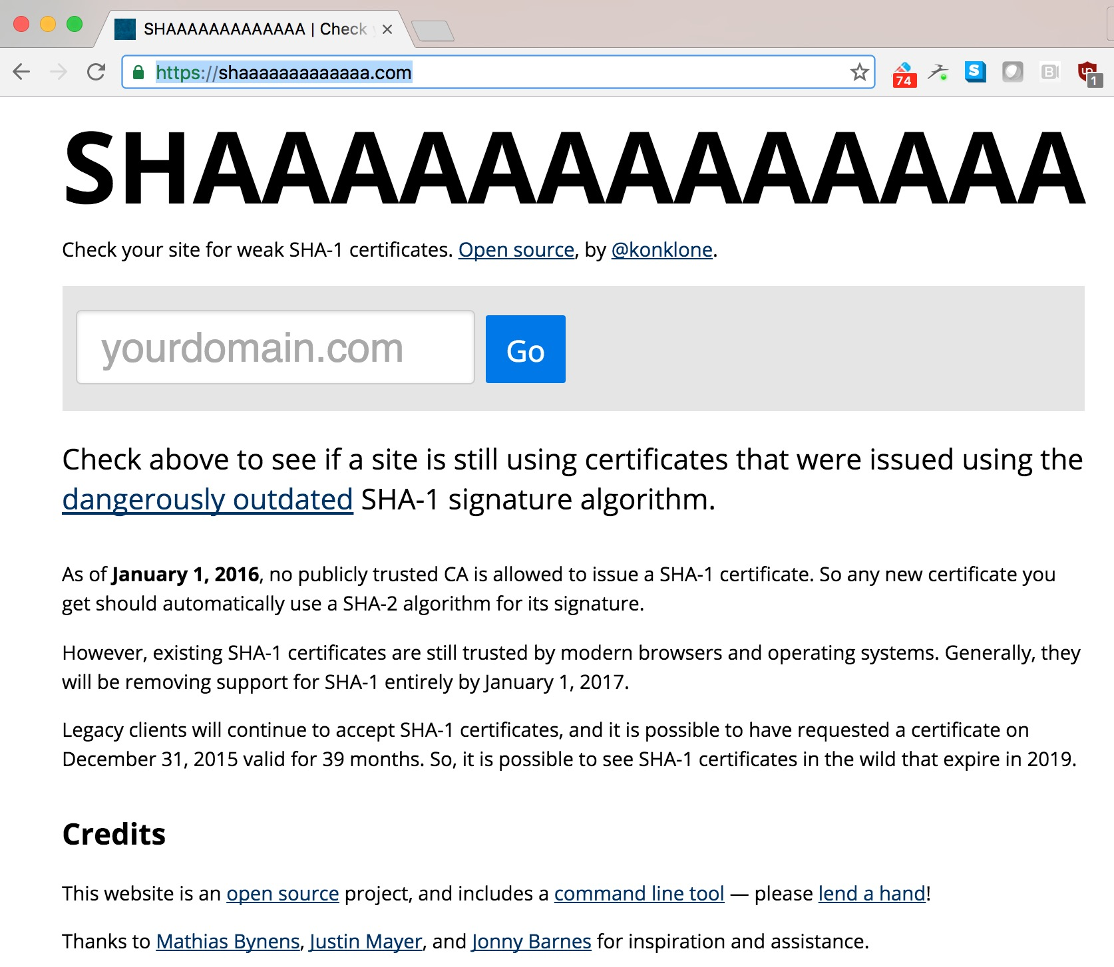
https://shaaaaaaaaaaaaa.com/
Notes:
https://konklone.com/post/why-google-is-hurrying-the-web-to-kill-sha-1
SHA1 collision cost: Burce Schneier - https://www.schneier.com/blog/archives/2012/10/when_will_we_se.html
Website for test: https://shaaaaaaaaaaaaa.com/
You can impersonate a SHA-2-signed cert with a SHA-1-signed forgery, because the browser will only be looking at the forgery and not know that there's a "real" cert or that that cert is "supposed" to be signed with SHA-2
“CAs MAY continue to sign certificates to verify OCSP responses using SHA1 until 1 January 2017.”

Slide 86
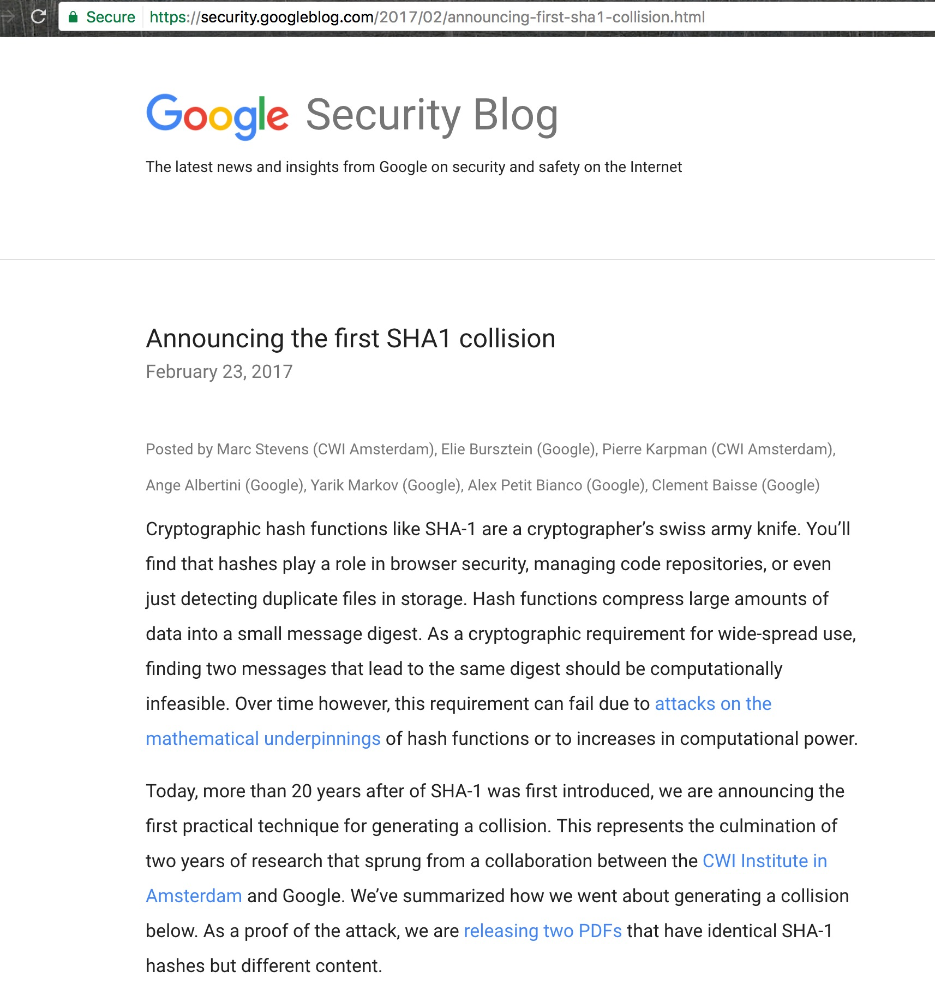
SHA1 Collisions No Longer Theoretical

Slide 87
Time to Retire RSA Key Exchange?
Doesn't support forward secrecy
Uses server key to encrypt the pre-master key created by the customer
Weakness: Server key (part of the cert) is typically very long lived
RSA (RC4 and DH) are not listed in Suite B, NSA and NIST approved list
Keys grow significantly larger
NIST Recommended Key Sizes
Protection Target | Symmetric | DH or RSA | ECC
05 Years to protection against agencies | 80 | 1024 | 160
20 Years to protection against agencies | 112 | 2048 | 224
30 Years to protection against agencies | 128 | 3072 | 256
Increase defense from quantum computers | 256 | 15360 | 512
Notes:
RSA for Key Exchange: Client generates a pre-master secret, encrypts with the server key and sends it in the ClientKeyExchange message. This provides both encryption and digital signing.
RSA is the de-facto standard key exchange mechanism. It's universally supported and thus very popular, but suffers from one serious problem—it doesn't support forward secrecy. As a result, it's slowly being replaced with other algorithms. The RSA key exchange is actually a key transport algorithm; client generates the premaster secret and transports it to the server encrypted using the server's public key.
Algorithms based on factoring need larger and larger keys while the ones based on Elliptic curve continue with small keys due to the problem complexity.

Slide 88
Conclusion

Slide 89

A Call to Action
  Make sure your ENTIRE WEBSITE or WEBSERVER is ALL HTTPS There is no excuse to not use HTTPS EVERYWHERE anymore
  HSTS Force the browser to always always use HTTPS and preload!
  Look into Certificate Transparency support as soon as possible
  Enable Certificate Authority Authorization if possible
  Keep Updated Make sure to always use modern ciphers
  OCSP Stapling privacy, efficient and safer revocation
Listen to the madman…
Notes:
expand upon this call to action.....

Slide 90
It’s been a pleasure. jim@manicode.com

