Slide 1
Building communities!
THREATCON (November 2018)
Matt Suiche
Founder, Comae Technologies
msuiche@comae.com @msuiche

Slide 2
Who am I? - @msuiche
Comae Technologies (www.comae.com)
Comprehensive Memory Forensics Platform
Stardust
Memory acquisition tool that works
DumpIt
Formerly called win32dd, exists since 2008 (10 Years!)
OPCDE (www.opcde.com)
Operation Community Development & Empowerment
Cybersecurity conference in Dubai, UAE & Nairobi, Kenya
Always looking for sponsors/patrons!
“a fun guy” according to TheShadowBrokers

Slide 3
The Dark Alley of Cyber

Slide 4
This is an open-question
What’s the best way
to communicate with other hackers?
share your research, or read people’s research?
and collaborate?

Slide 5
Lot has happens over the past 30+ years
According to Wikipedia the first hacker conference was in 1984 in Marin County, California, by Stewart Brand.
CCC founded in 1981 in Berlin, Germany.
C-base hackers space in 1995.
But we mainly know DEF CON (1993) by 18yo Jeff Moss.
Time flies man!
Mainly U.S. centric but expanded all over
(next slides)

Slide 6
SysCan, Ekoparty, H2HC, CCC, HITB, ZeroNight, OffensiveCon, Bsides, Infiltrate etc.
and some corporates ones like
Microsoft’s BlueHat, Kaspersky’s SAS, Tencent’s TenSec or CrowdStrike’s FalCON.

Slide 7
Format
Conferences
Hackerspace
Online forums (crackers, etc.)
IRC
Twitter
Slack
Blogposts
Ezines (ZF0, PoC||GTFO, etc.)
Etc.

Slide 8
Impact of the security community
Social
Research focused
Harder to get time-value from non technical conferences unless you have something to sell.
Industry Impact
Improved communication with vendors A LOT. BlueHat is a good example.
Hackers were demonized for a while.
Still get “Are you a good or a bad hacker” or “are you an ethical hacker?”
CEH made that silly use of the ethical mainstream. Why silly? Because the wording implies hackers are bad unless they don’t have the certification.

Slide 9
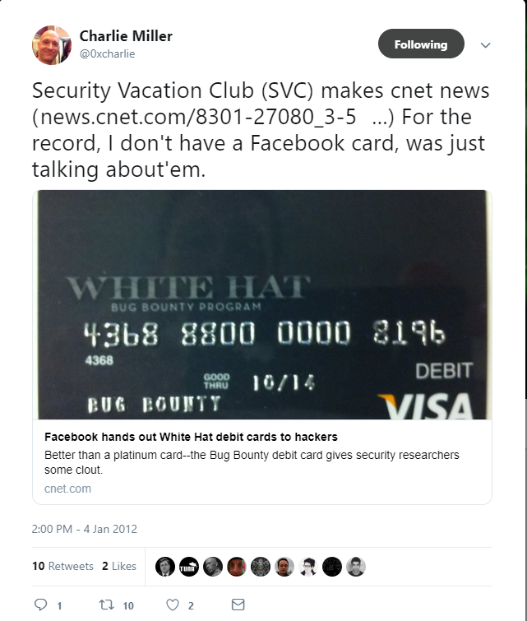

Slide 10
Join us!
Join our community on Slack and learn more about how we can build communities from scratch and bridge the gap between mature and nascent communities
http://opcde.com/opcdex.html
Twitter: @OPCDE

Slide 11
Thank You!
msuiche@comae.com
@msuiche

